Slide 1
UIC and Global Liberal Arts
Adrian J. Bailey
Associate Vice President (Internationalization)

Slide 2
Outline
(a) Introduction to UIC
First Mainland – Hong Kong University“joint venture”
(b) Our Global Liberal Arts ethos
Whole Person
Transdisciplinary
Engaged

Slide 3
First-ever tertiary institution set up by the joint endeavour of a mainland and Hong Kong university (2005)
Founded in 1902
985，double-first class
State key university directly under MOE
Founded in 1956
Hong Kong public university
One of Asia’s most excellent institutions

Slide 4
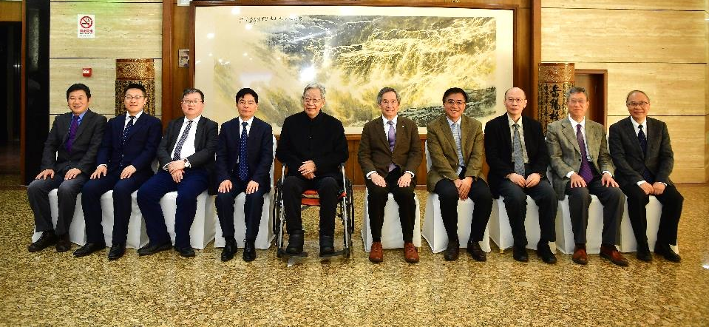
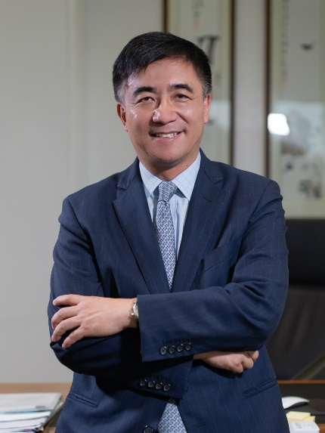
Leadership
The Council and the President
President
Founded in 2005 with 10 members from BNU and HKBU.
The highest governing body.
Recruited globally and appointed by the Council.
Responsible for academic and administrative affairs.

Slide 5
Innovative liberal arts in China and globally
Mission
Strategic Positioning
Character
Liberal arts college dedicated to producing well-rounded global talents
A liberal arts college rooted in excellence in undergraduate education and graduate programmes
Academic meritocracy Language proficiency National anchoring International orientation

Slide 6
Faculty
33 countries and regions
542 fulltime teaching staff, 392 lecturers/assistant professors and above, 71% with doctoral degree.
10 chair professors, 35 professors, 76 associate professors.
As of Feb. 2022

Slide 7
Faculty
Top100 in High-level Talents Ranking
Ten UIC Scholars Listed In World’s Top 2% Scientists
Stanford University selected the top 2% from nearly 7 million scientists worldwide from 176 sub-disciplines under 22 fields in arts, science and engineering. The result indicates that the 10 selected UIC scholars have made a high world impact in their research fields and outstanding contributions to those fields.
In 2020, UIC has been the only university on the list outside Guangzhou and Shenzhen in Guangdong province.

Slide 8
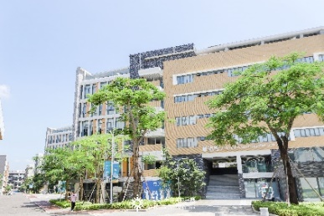
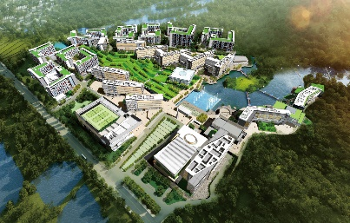
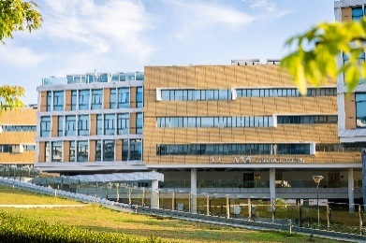
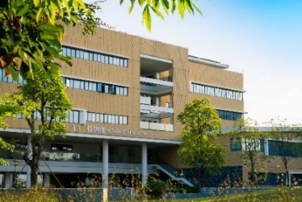
Programmes and Students
DBM
DCC
GS
Division of Business
and Management
Division of
Culture and Creativity
Graduate School
DHSS
DST
Division of Humanities and Social Sciences
Division of
Science and Technology
28 undergraduate programmes
Accredited by Hong Kong Baptist University and meeting MOE guidelines
Undergraduate students: over 7000

Slide 9
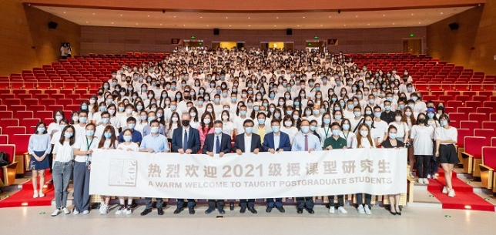
Postgraduate Education
Provision of postgraduate programmes approved by MOE in 2016.
Probability and Mathematical Statistics, Biology, Chemistry, Computer Science and Technology, Accounting and Business Management, Economics, Applied English Linguistics, Communication , Applied Mathematics, etc.
Postgraduate students on campus: nearly 700

Slide 10
Graduates
1523 Graduates in 2021
Further study in Chinese Mainland: 38
Employed: 219
Entrepreneurship and others: 20
As of Feb. 2022

Slide 11
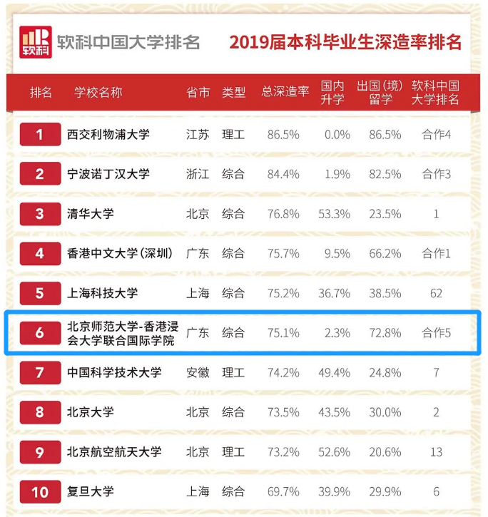
The Shanghai Ranking Consultancy ranked UIC sixth in China in 2020 in the proportion of undergraduates seeking further studies upon graduation.

Slide 12
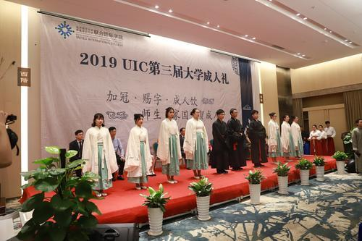
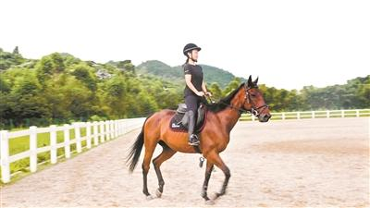
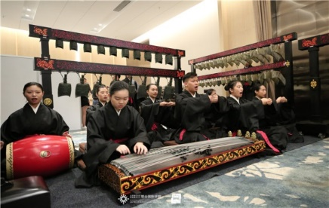
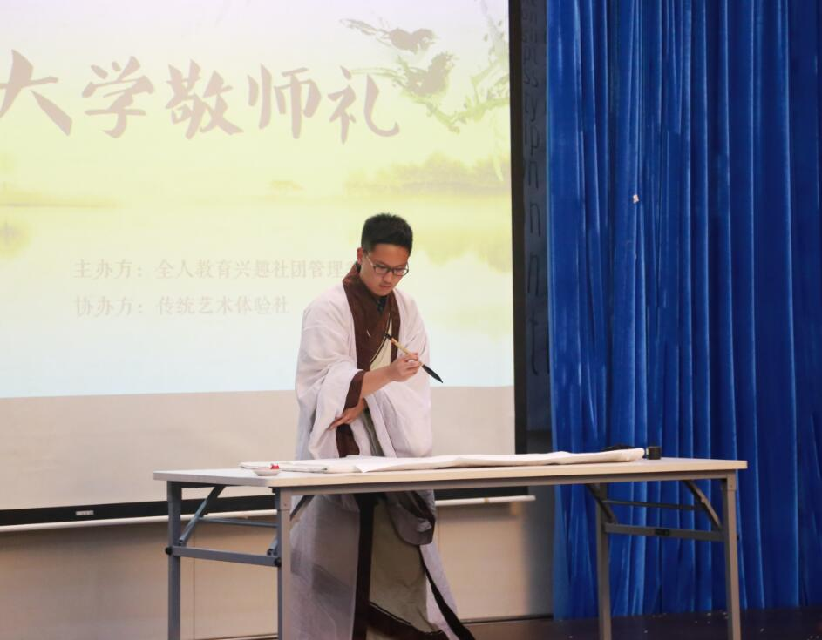
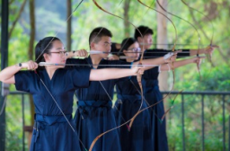
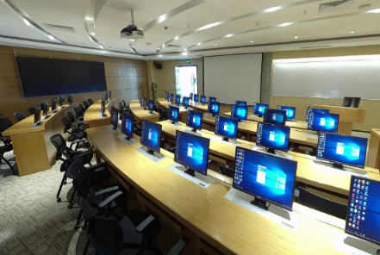
(b) Our Global Liberal Arts ethos
Whole Person
Major study plus general education
Student-teacher interaction
Transdisciplinary
Drawing on Chinese and Western thinking
Engaged
Social practice and experiential learning
Localization
Six Arts of ancient rituals, music, archery, charioteering, calligraphy and mathematics

Slide 13
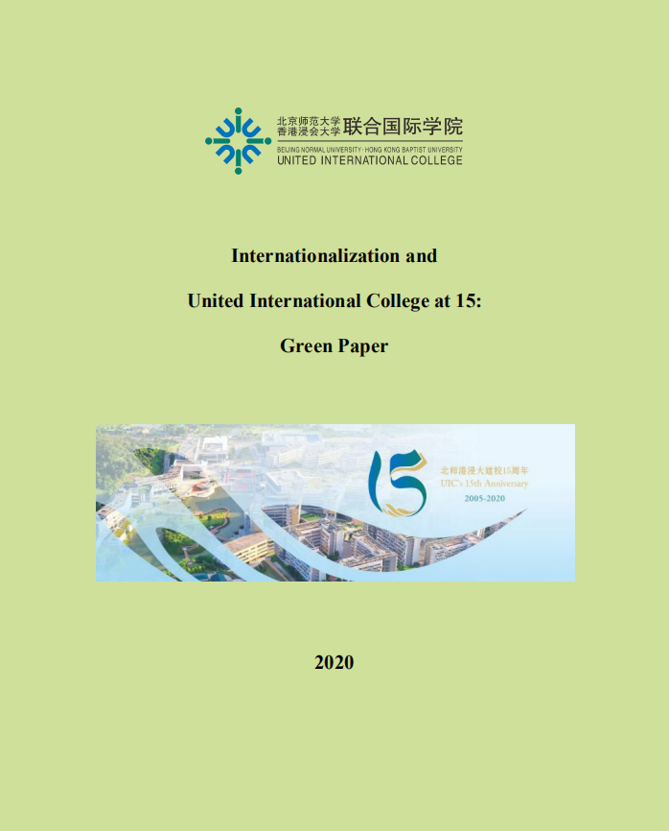
Our Global Liberal Arts ethos is enshrined in Internationalization Strategy (UIC Green Paper 2020)

Slide 14
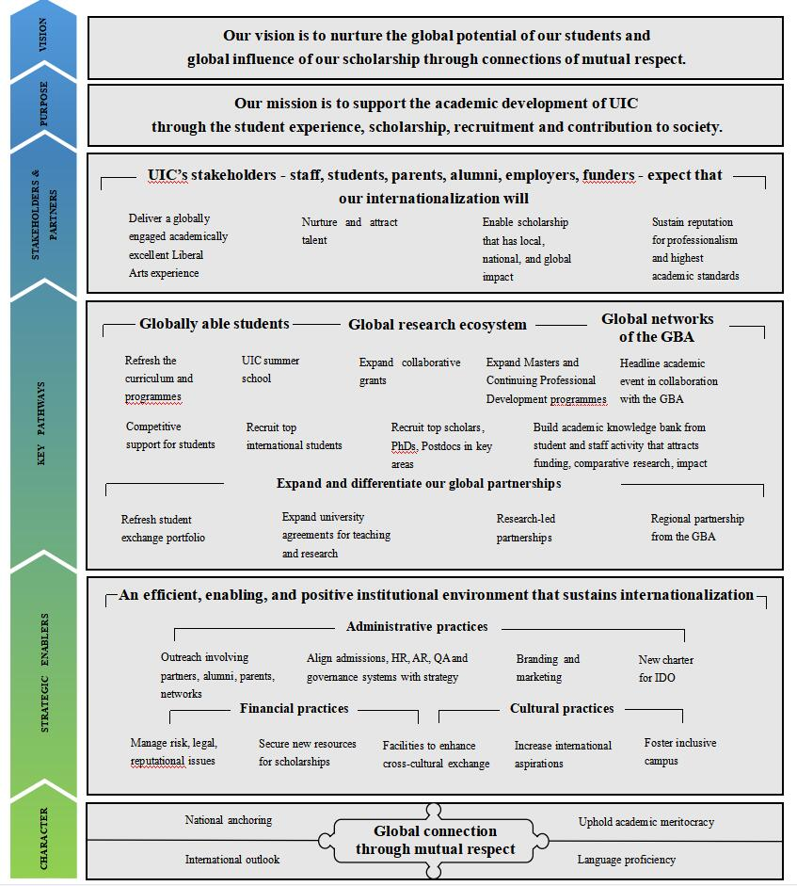
Internationalization
Strategy

Slide 15
Strategic Pathways
Pathway 1 Globally able students
Aims | Indicative Actions
Raise the aspirations and competencies of students to enable them to acquire resilience, cross-cultural strategies, multi-literacy, and resourcefulness | Curricula reform 1. Require an international experience 2. Student-led curricula and co-curricular initiatives with overseas students 3. Foreign language training 4. Chinese language instruction for non-Chinese speakers 5. New Undergraduate and Master courses 6. Simplify Credit Transfer Process 7. Expanded Exchange opportunities 8. Enable outbound students to participate in Internships overseas 9. Global Learning Passport
Create inclusive campus that promotes diversity and creativity | 1. Hold “Global Connect Festivals” 2. Review accommodation and facilities provision 3. UIC Summer School
Recruit talented international students to campus | 1. Marketing 2. Enhanced resources 3. Frequent outreach
Develop students to be UIC international ambassadors, and contribute to UIC life as student ambassadors | 1. Provide funding opportunities 2. Improve the opportunities and increase the expectation of performance

Slide 16
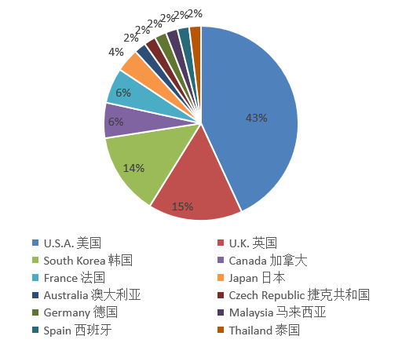
Global Partnerships
UIC has partnerships with 63 universities:
President Tang and Provost Chen are early supporters of the development of PALAC as a network of like-minded liberal arts institutions

Slide 17
Strategic Pathways
Strategic Pathways
Pathway 2 Global research ecosystem
Aims | Indicative Actions
Work at the highest standards of research accomplishment | 1. Provide opportunities for UIC PhD students to study overseas and overseas PhD students to visit UIC on a research placement 2. Develop Type B research-led and C partnerships between a faculty/ faculty team/ research centre at UIC and a complementary unit offshore 3. Develop a Summer School at UIC 4. Clarify performance expectations at Division level
Compete for research funds | 1. Support faculty in co-applications for international research funding 2. Establish a small seed fund
Compete for talents | 1. Develop and curate a data archive, museum, or other specialized resource 2. Boost international research and network participation
Contribute to the multilateral development of the global academic commons | 1. Encourage faculty to take sabbatical leaves overseas 2. Integrate Overseas teaching with faculty research agendas 3. Encourage faculty to participate in overseas conferences, serve on international editorial boards

Slide 18
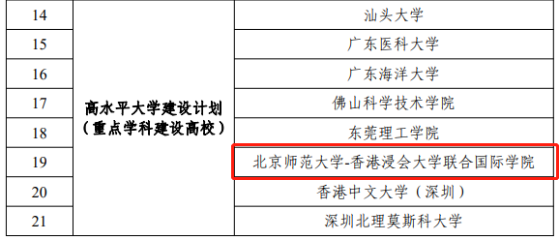
Global Research Ecosystem: Construction of Key Disciplines
UIC selected for Guangdong high-level university development plan
The Government of Guangdong province issued an implementation plan for improving the quality of higher education in the Guangdong province (2021-2025).
UIC competed and has been selected for the high-level university development plan (under the category of universities with key disciplines) of Guangdong.

Slide 19
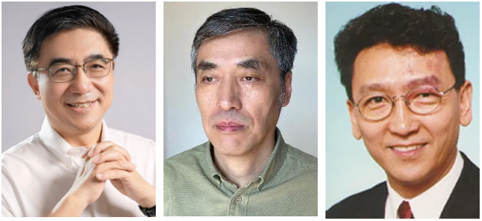
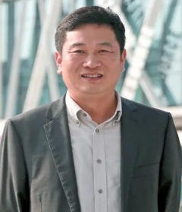
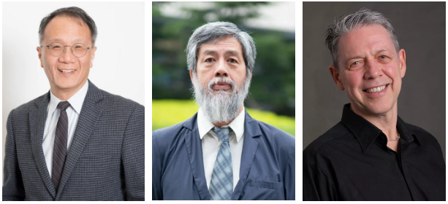
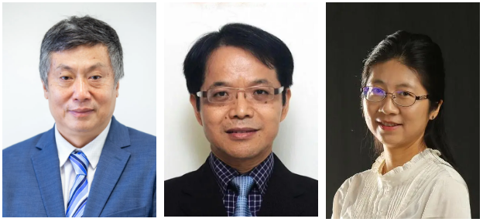
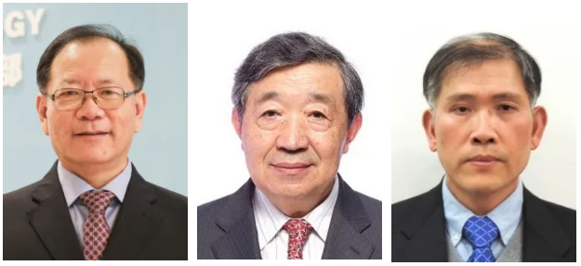
Provincial Key Disciplines
Mathematics
Scientific and engineering computing
Applied partial differential equations
Financial mathematics
Communication Studies
Chinese Culture and Global Communication
Studies on Communication theories
Studies on Communication practice
Computer Science and Technology
Artificial intelligence and multimodal data processing
Industrial Internet of Things and intelligent systems
Intelligent visual interaction and image detection
Statistics
Biostatistics and healthcare, experimental design
Intelligent manufacturing
Financial statistics big data

Slide 20
Strategic Pathways
Pathway 3 Global networks of the Greater Bay Area
Aims | Indicative Actions
Recognize the importance of localization | 1. Offer targeted continuing professional development courses 2. Build Type D Partnerships with overseas collaborators 3. Launch headline academic events and Global Connect festivals in collaboration with stakeholders in the GBA 4. Explore flexibility in visa and work permit arrangements
Bring benefits of talent development, recognition, and a culture of innovation to the GBA
Gain support from businesses and government
Anticipate training and human capital development needs arising the GBA

Slide 21
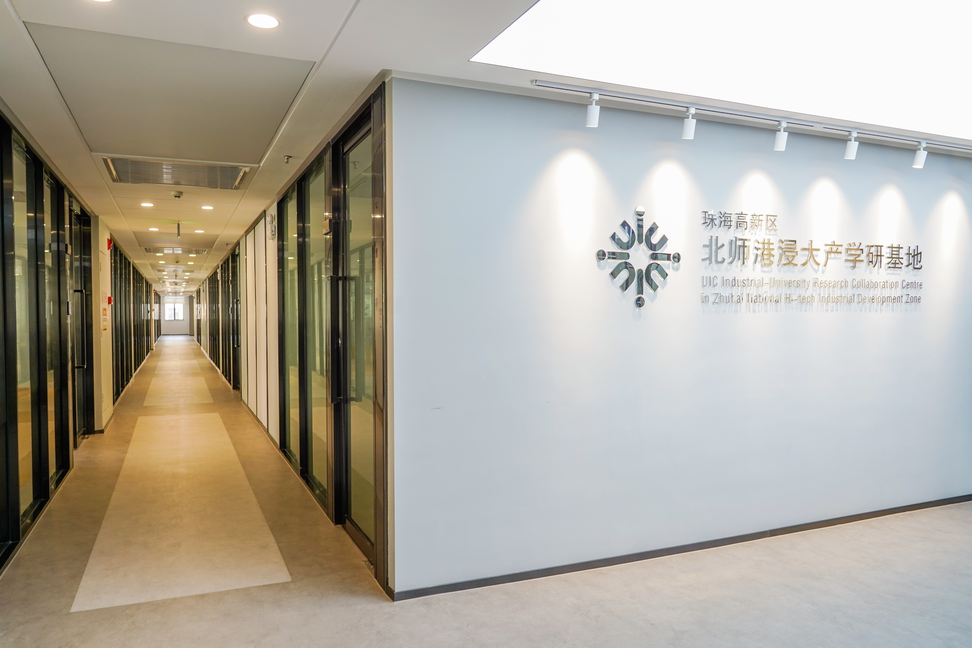
Engaged: Strengthen Cooperation with local government
Industrial-university research projects:
Big Data and Artificial Intelligence
High-tech software
Intelligent imaging and diagnostic software
Industrial-University Research Collaboration Centre in Tech Bay at Zhuhai Hi-Tech Industrial Development District
More than 20 start-ups by the end of 2021. Operating in different sectors, including Artificial Intelligence , Internet of Things , biomedicine, creative culture, etc.

Slide 22
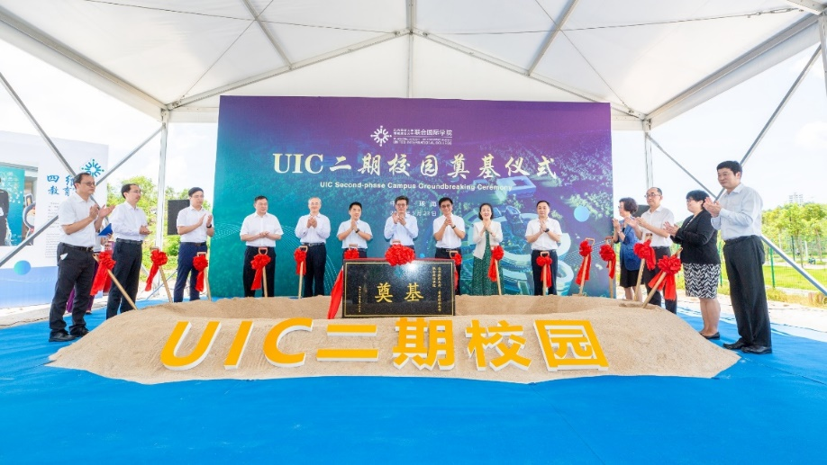
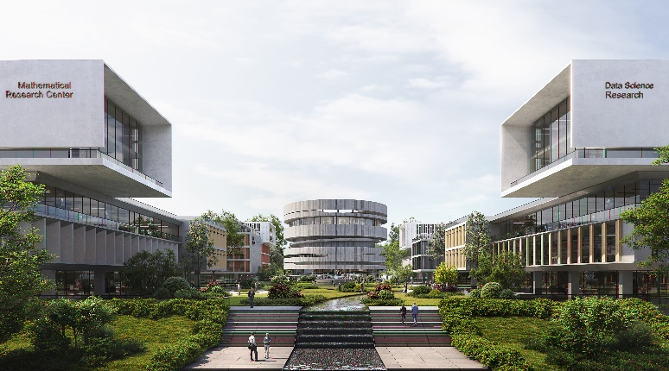
Engaged: Strengthen Cooperation with local government
Joint Construction of the Second-phase Campus
Building area of approx. 400,000 square meters.
The bases of science, engineering, interdisciplinary subjects, cutting-edge technologies and industrial transformation.
Three clusters of scientific research buildings, teaching blocks and residence halls (capacity of 5,000 students and 700 staff members）.
Project expected to be fully put into use in September 2025. Building a university town with the historical Huitong Village.
Groundbreaking ceremony on 23 May 2021

Slide 23
Second phase
“Science Programme, Graduate School”
2020年6月30日，珠海市人民政府和北师港浸大签署合作协议，建设高水平二期校园，二期校园面积约550亩。
科技、研究生院
First phase
“Humanity, Business”

Slide 24
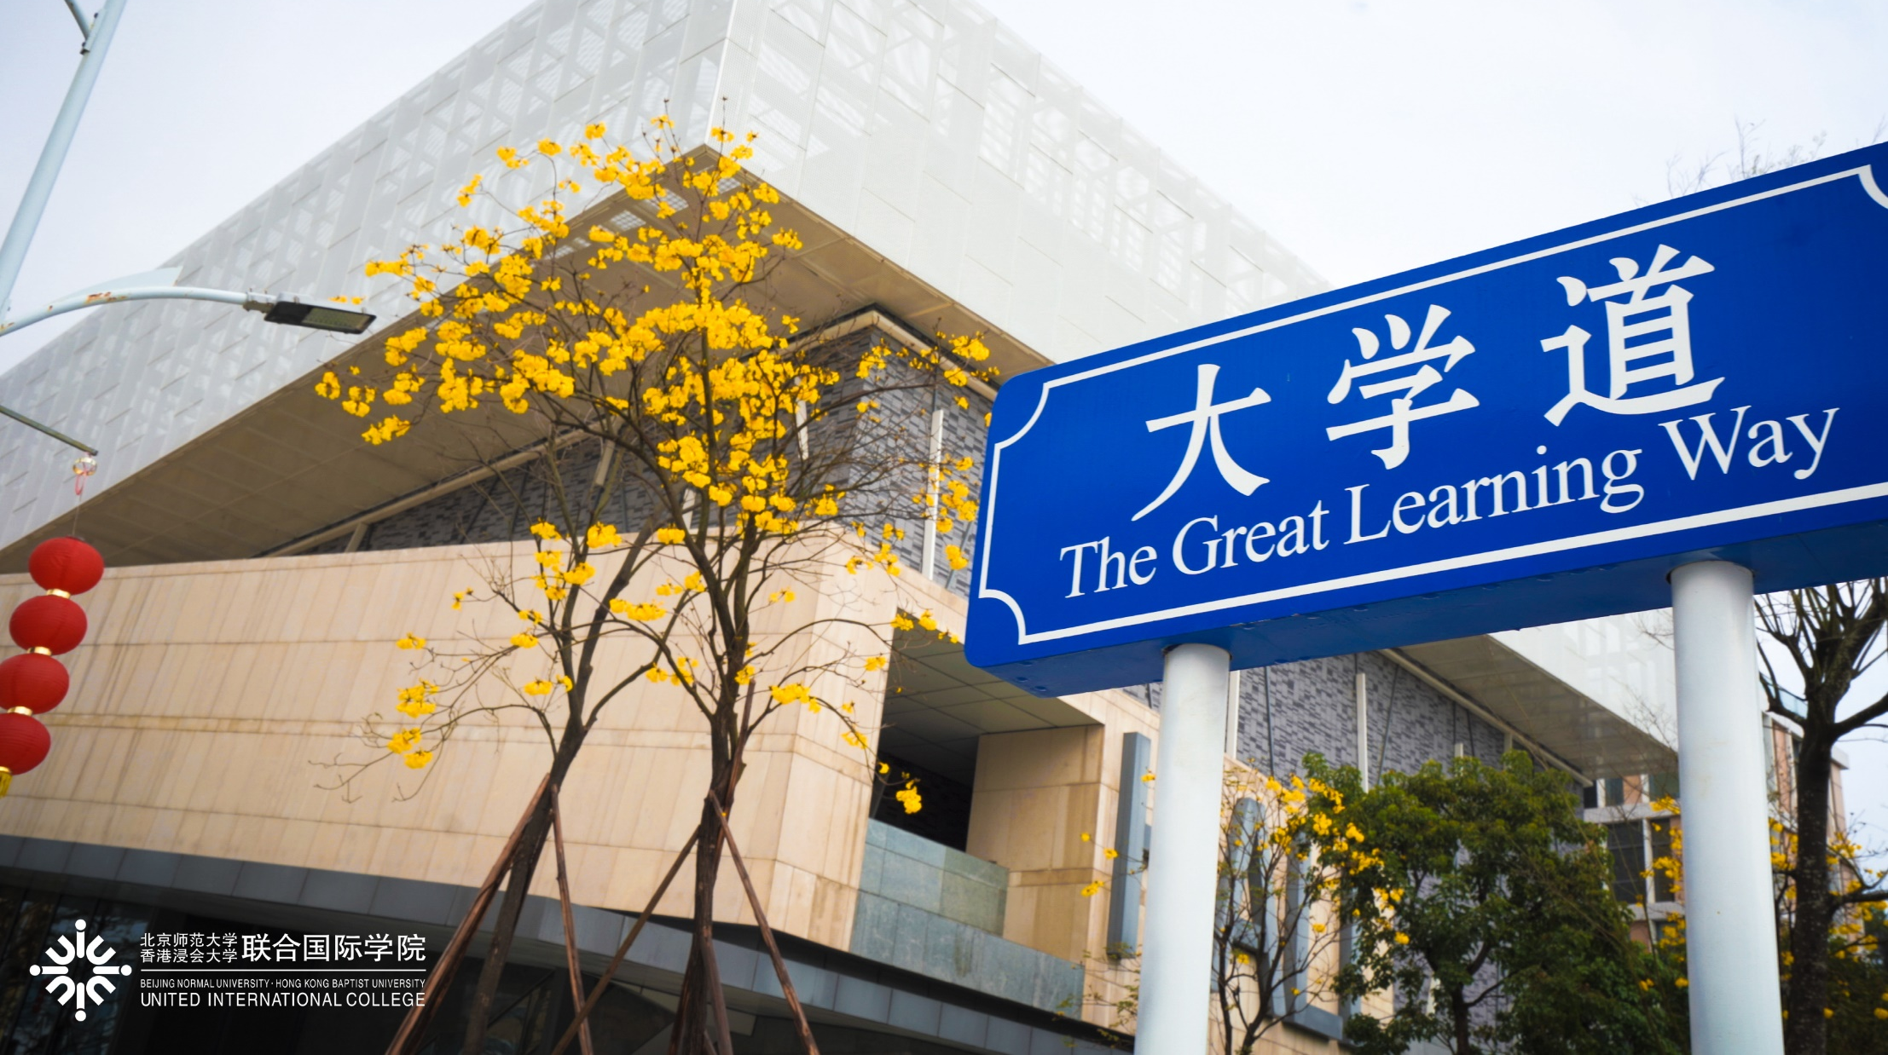
Look forward to further dialogue!
Thank you!

