Slide 1
Scott MacEachern, PhD. 斯科特·麦凯克恩 教授 Vice Chancellor for Academic Affairs,
Professor of Archaeology and Anthropology, DUKE KUNSHAN UNIVERSITY
昆山杜克大学 学术事务副校长、考古学和人类学教授
COPYRIGHT © 2021 DUKE KUNSHAN UNIVERSITY.

Slide 2
About DUKE KUNSHAN UNIVERSITY
关于昆山杜克大学
Sino-US Joint Venture University with independent legal status
具有独立法人资格的非营利性中外合作大学
Accreditation approval by
China’s Ministry of Education in September 2013
2013年9月经教育部批准正式设立
Duke-standard education and research
杜克标准的教育品质和科研实力
Inaugural class of students in August 2014
2014年8月正式开学
(研究生教育和本科学期项目)
Comprehensive, research oriented,
highly selective, international and world-class
综合性、研究型、精英式、国际化、世界一流
UG degree program launched August 2018
2018年8月正式开启四年制本科学位教育

Slide 3
Phased Approach towards a World-class University 分阶段建成综合性研究型世界级学府
Phase 1 第一期阶段
(2013-2018)
Phase 2 第二期阶段
(2018-2022)
Phase 3 第三期阶段
(2022-2026)
To offer a number of master degree programs, a non-degree undergraduate semester program, and research centers. On-campus students up to 700.
逐步开设若干硕士研究生学位教育项目，以及非学历学位的本科学期项目，在校生人数不超过700人
To offer more graduate and professional degree programs (including PhD programs if conditions are met) and research centers; to gradually offer undergraduate degree programs in arts & humanities, social sciences and natural & applied sciences. On-campus students up to 2,000.
开设更多研究生学位项目和专业学位项目（条件允许时包括博士学位项目）及研究中心，逐步开设人文、社会和自然科学以及艺术领域的本科学位教育项目，在校生人数不超过2000人
To establish a complete education and research system with undergraduate, master and doctoral degree programs; to basically realize the strategic goal of building a world-class university. On-campus students up to 3,500.
构建起完整的本科、硕士、博士学科专业教育体系和科学研究平台体系，基本实现建立一所具有世界级教育和研究水平的综合性大学的战略目标，在校生人数不超过3500人
You are here for Phase 2
(当前所在阶段)

Slide 4
21st Century Higher Education 21世纪高等教育
Innovative problems solving skills
创新的问题解决技能
Strong sense of civic responsibilities
富有社会责任感
Foresight and vision
前瞻和视野
Interdisciplinary knowledge
跨学科知识
Integration, innovation, adaptation
融合、创新、适应
Cross-cultural communication skills
跨文化沟通能力
Collaborative team work
团队合作精神
Globalization
全球化
Complex problems such as those in health, environment, political and religious conflicts, global economy, and energy challenges…
存在健康、环境、社会政治冲突、全球经济、能源等领域的各种复杂问题和挑战
Liberal Arts Education and new opportunities
通识博雅教育和新的机遇
Notes:
A 21st Century Curriculum
The Duke Kunshan curriculum begins from liberal arts principles and is imbued with the hallmarks of a Duke education blended with Chinese tradition: interdisciplinary approaches, engagement with research questions, problem-based and team-based learning, and opportunities for students to craft individual pathways and deepen their intellectual engagement over time. It is a kind of education that builds critical and problem-solving skills, simultaneously conferring a broad base of knowledge and fostering the ability to interrogate that knowledge and apply it flexibly. It is also deeply cross-cultural in its orientation: Duke Kunshan gives all participants the continual experience of learning to see from multiple points of view and to work together across cultural boundaries—a crucial skill for the future.
A Liberal Arts College Experience
The small-scale residential setting at Duke Kunshan offers significant opportunities for innovative and integrated forms of learning, an especially close connection between faculty and students, and the intermixing of students with different interests. In addition, Duke Kunshan offers creative alignments between its undergraduate curriculum and selected areas of research strength at Duke Kunshan and at Duke. Liberal arts colleges provide direct access to research opportunities for undergraduates – they leverage their small size, commitment to teaching to provide opportunities for one-on-one and small team-based scholarly mentoring. In the United States, liberal arts colleges disproportionately produce students who go on to earn PhD’s. Duke Kunshan offers the same kinds of focus on discovery and the co-creation of knowledge as at liberal arts colleges with the added dimension of research centers on site and connections to a major research university in the United States and to Wuhan University in China.

Slide 5
Liberal arts education – characteristics 通识博雅教育 – 特点
Broadly based, often interdisciplinary
涉猎广泛、跨学科
Major requirements complete in 2-3 years
专业课要求在2-3年内完成
The creation of informed citizens,
not specialists
培养通才，而非专才
Central role of
academic advisors (usually faculty)
学术顾问的核心作用（通常是教授）
Common core/distribution requirements
公共核心课、跨领域课程分布要求
Teaching by full-time faculty
全职教授授课
Delayed choice of major
(by end of second year)
入学不分专业，大二结束前自主选择
Small class sizes/intensive
interaction with faculty
小班教学、与教授紧密互动

Slide 6
Liberal arts education – advantages 通识博雅教育 – 优势
Student learning in small classes
小班教学
Intensive faculty support
教授提供强有力的支持与保障
Faculty expertise in teaching
教授专业化教学
High levels of identification with the institution
学生对学校的高度认同
High-levels of post-graduate success, especially in graduate schools
高水平升学就业、继续深造成果显著

Slide 7
Seven Principles
七大原则
Rooted Globalism
有根的全球意识
Lucid Communication
丰富的沟通技巧
Collaborative Problem-Solving
协同解决问题的能力
Research and Practice
研究与实践
Independence and Creativity
独立探索与创造精神
A Purposeful Life
有追求的人生
Wise Leadership
英明的领导力
Notes:
These seven principles are expressed throughout the curriculum, and constitute its overarching goals:
Rooted Globalism: To cultivate informed and engaged citizens who are knowledgeable about each other’s histories, traditions of thought and affiliations; and skilled in navigating among local, national and global identities and commitments.
Collaborative Problem-Solving: To instill the habits of collaboration and the ability to synthesize disparate insights in solving complex challenges.
Research and Practice: To enhance the ability to forge links between theory and practice in the many-sided and rapidly changing world of human need.
Lucid Communication: To develop the ability to communicate effectively, both orally and in writing, and to listen attentively to different viewpoints in coming to mature judgments.
Independence and Creativity: To nurture free inquiry, deep reflection and a drive to ask interesting questions and find compelling answers.
Wise Leadership: To shape thinkers and doers who possess the moral compass to guide communities and institutions toward a common good and who have the wisdom and technical competence to deal effectively with complexity.
A Purposeful Life: To form reflective scholars who test their core beliefs, connect their course of study to big questions of meaning, and who build the capacity for lifelong learning and exploration.

Slide 8
Undergraduate Majors
DKU Major Name
ID | D
Applied Math & Computational Science | Math
Behavioral Science | Psychology
Behavioral Science | Neuroscience
Cultures and Movements | Cultural Anthropology
Cultures and Movements | Sociology
Cultures and Movements | World History
Data Science
Environmental Science | Biogeochemistry
Environmental Science | Biology
Environmental Science | Chemistry
Environmental Science | Public Policy
Ethics and Leadership | Philosophy
Ethics and Leadership | Public Policy
Ethics and Leadership | Religious Studies
Global China Studies | Chinese History
Global China Studies | Economics
Global China Studies | Philosophy
Global China Studies | Political Science
Global China Studies | Religious Studies
Global Cultural Studies | World History
Global Cultural Studies | World Literature
DKU Major Name
ID | D
Global Health | Biology
Global Health | Public Policy
Institutions and Governance | Economics
Institutions and Governance | Political Science
Institutions and Governance | Public Policy
Material Sciences | Chemistry
Material Sciences | Physics
Media and Arts | Art History
Media and Arts | Creative Practice
Molecular Bioscience | Biogeochemistry
Molecular Bioscience | Biophysics
Molecular Bioscience | Cell and Molecular Biology
Molecular Bioscience | Genetics and Genomics
Political Economy | Economics
Political Economy | Political Science
Political Economy | Public Policy
US Studies | American History
US Studies | American Literature
US Studies | Political Science
US Studies | Public Policy

Slide 9
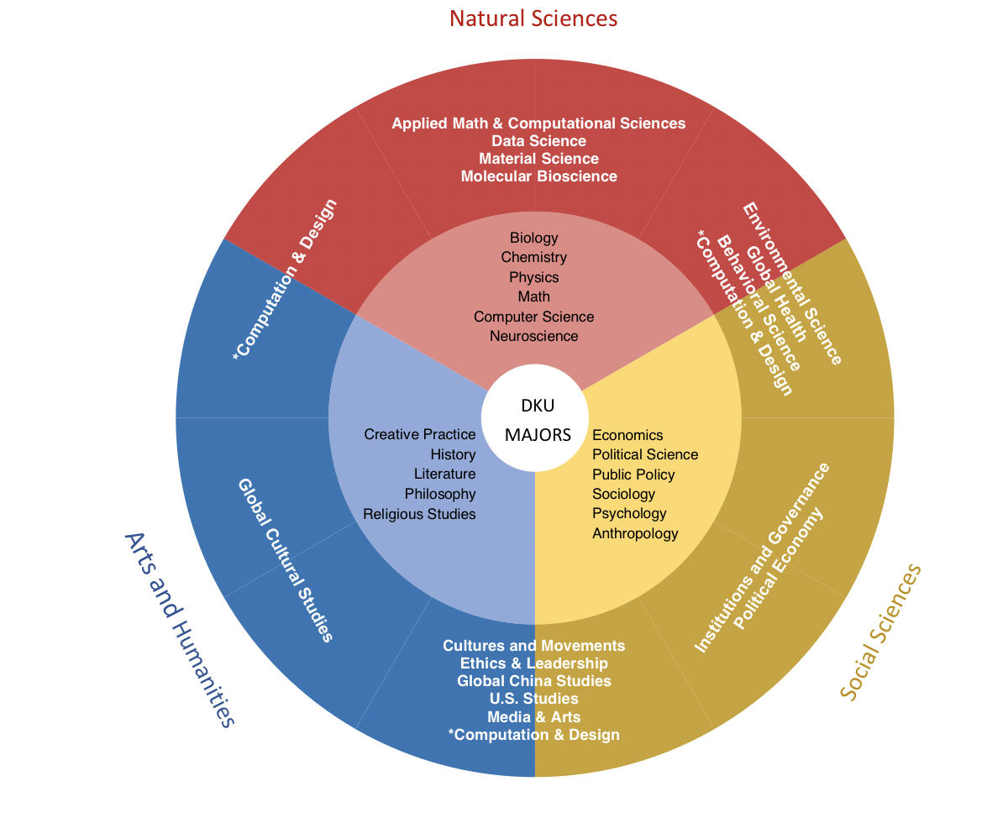
Notes:
Diagram: https://web.williams.edu/Mathematics/devadoss/careerpath.html
The left side of the circle is broken into 15 parts, each representing a grouping of all majors available at Williams. For example, "Cultural Studies" includes such majors as Anthropology, Sociology, and Asian Studies. The right side of the circle is similarly broken into 15 parts, each representing a grouping of possible careers chosen by Williams alums.

Slide 10
Course Distribution 课程分布
Year 1一年级
Year 2二年级
Year 3三年级
Year 4四年级
Common Core 公共核心课
Language 语言课程
Divisional Foundations 领域基础课
Interdisciplinary studies 跨学科专业课程
Major
专业
Disciplinary Studies 传统专业课程
Signature Work: Experiential Education, Internships, Research 标志性成果: 实践性教育，实习，科研
Electives & Pass-Fail Mini Terms
选修课 & 迷你小学期
Study abroad at Duke or elsewhere
在杜克或其他大学进行海外交换
Notes:
Common Core courses required of all students focus on big questions and critical challenges and students take one per year for three years.
Language courses required in English, Chinese or potentially a third language.
Divisional areas of knowledge organize the faculty and the curriculum – Natural Sciences; Social Sciences; and Arts and Humanities – rather than traditional majors or departments.
Majors that have interdisciplinary and disciplinary components, with the former serving as the entry point and primary definition of a students’ academic community and the latter providing specialized training, as well as divisional foundation courses that prepare students for advanced study and
Signature work that focuses on a question, problem or issue and includes independent research, a senior thesis or creative production.
Electives that broaden students’ educational experience via simple distributional requirements and additionally enable them either to develop greater specialized knowledge or to further increase the breadth of their study.
Experiential opportunities that align the formal curriculum with practica, internships and other hands-on offerings are required and available as electives.

Slide 11
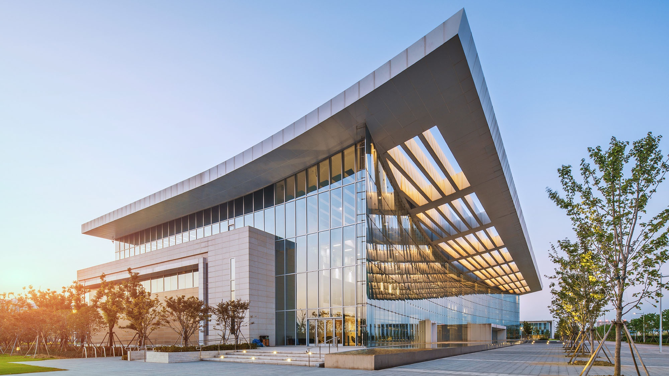
Existing Graduate Programs 目前开设的硕士研究生项目
MASTER OF SCIENCE IN GLOBAL HEALTH (2-year)
全球健康理学硕士(2年)
MASTER OF SCIENCE IN MEDICAL PHYSICS (2-year)
医学物理理学硕士(2年)
MASTER OF MANAGEMENT STUDIES (1-year)
管理学硕士 (1年)
MASTER OF ENVIRONMENTAL POLICY (2-year)
环境政策硕士 (2年)
MASTER OF ELECTRICAL AND COMPUTER ENGINEERING (2-year)
电子与计算机硕士 (2年)

Slide 12
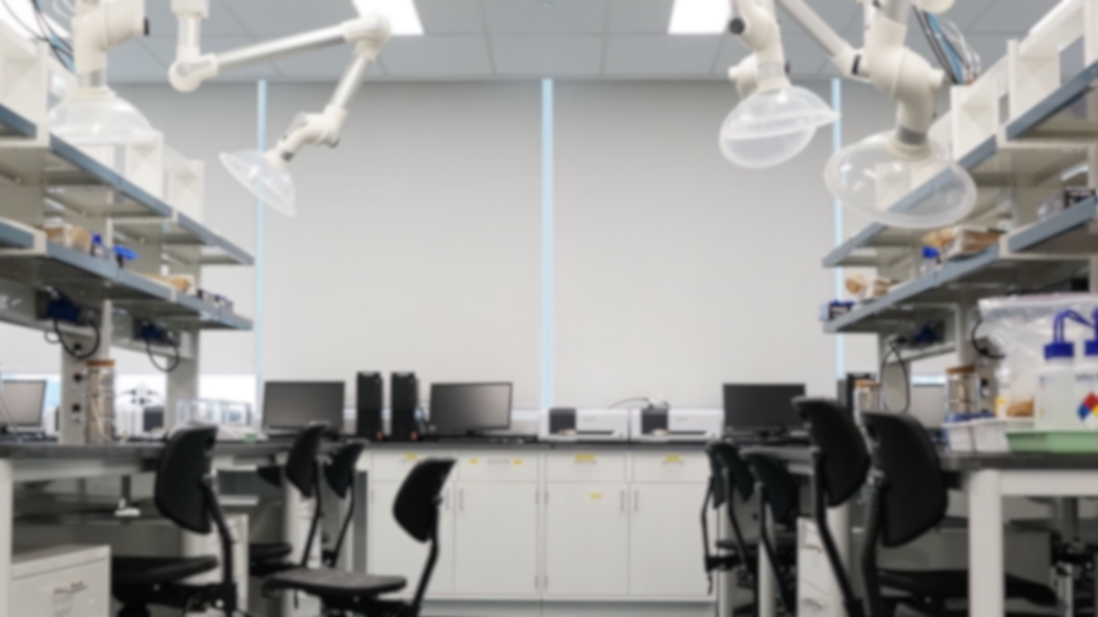
Integration of interdisciplinary research and education
科研与教学密切结合
Environmental Research Center
环境研究中心
Language and Culture Center
语言文化中心
Global Health Research Center
全球健康研究中心
Center for the Study of Contemporary China
当代中国研究中心
DKU Research Centers and Institutes
昆山杜克大学
科研机构
Institute of Applied Physical Sciences and Engineering
应用科学与工程科研所
Regional Ozone Sino-US Research Center
区域臭氧中美合作研究中心
Data Science Research Center
大数据研究中心
Zu Chongzhi Center for Mathematics and Computational Sciences
祖冲之数学与计算科学中心
WHU-DUKE Research Institute
武大-杜克科研所
China Innovation Research and Training Center
中国创新研究与培训中心
Humanities Research Center
人文研究中心

Slide 13
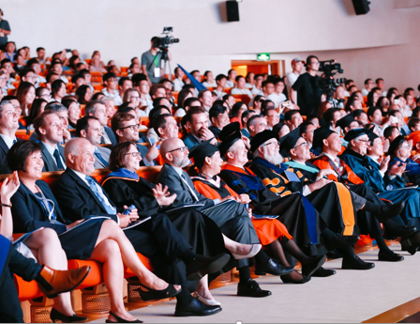
Faculty 师资
Globally-recruited faculty
全球遴选师资
Visiting faculty from Duke University, Wuhan University and other top universities from across the world
来自杜克大学、武汉大学和国内外知名 高校大学的客座教师
Actively engaging in teaching, research and service
积极参与教学、科研和社会服务
Faculty driven advising model
教师指导为主的学业指导模式

Slide 14
Thank you! 感谢！

