Slide 1
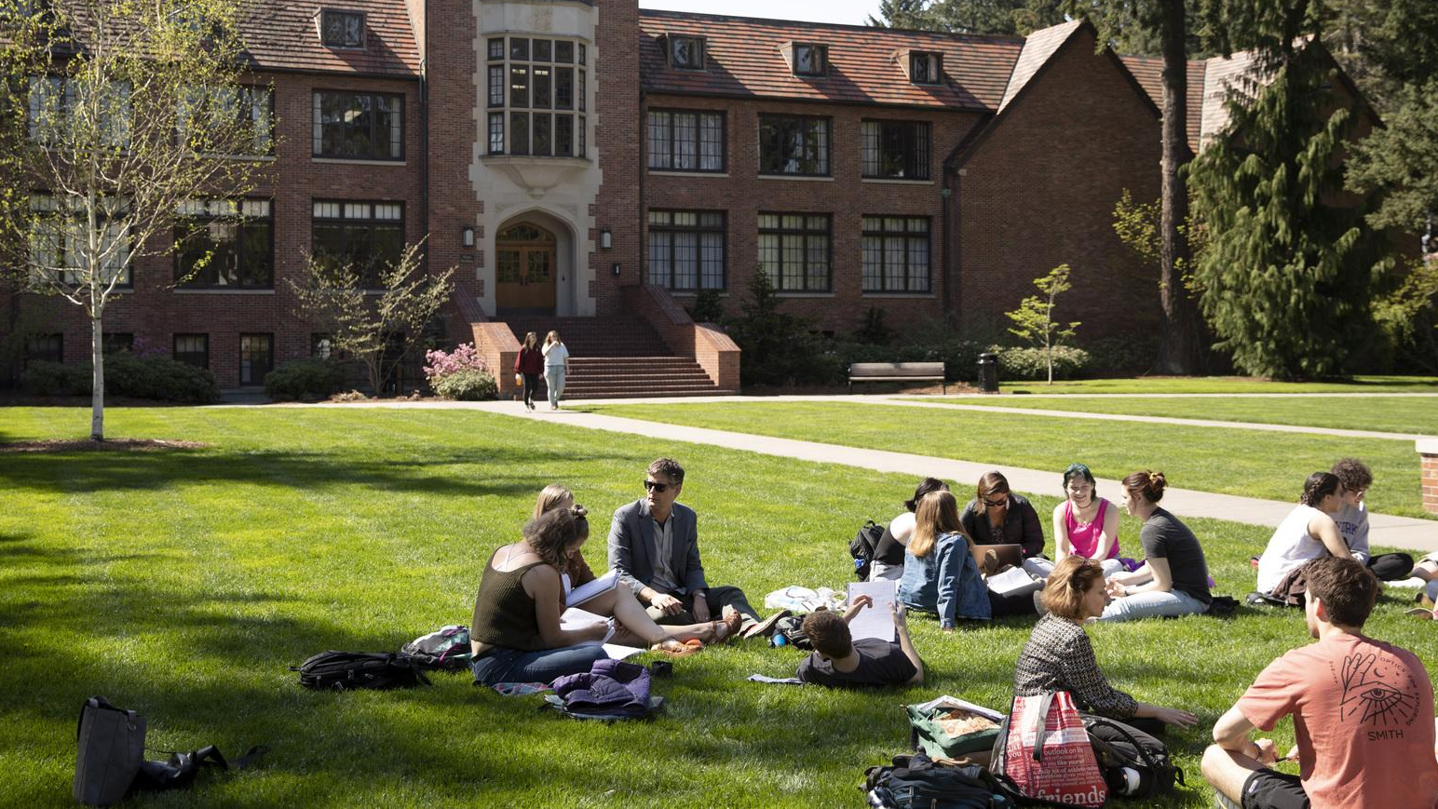
Pacific Alliance of Liberal Arts Colleges
June 3, 2022

Slide 2
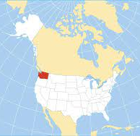
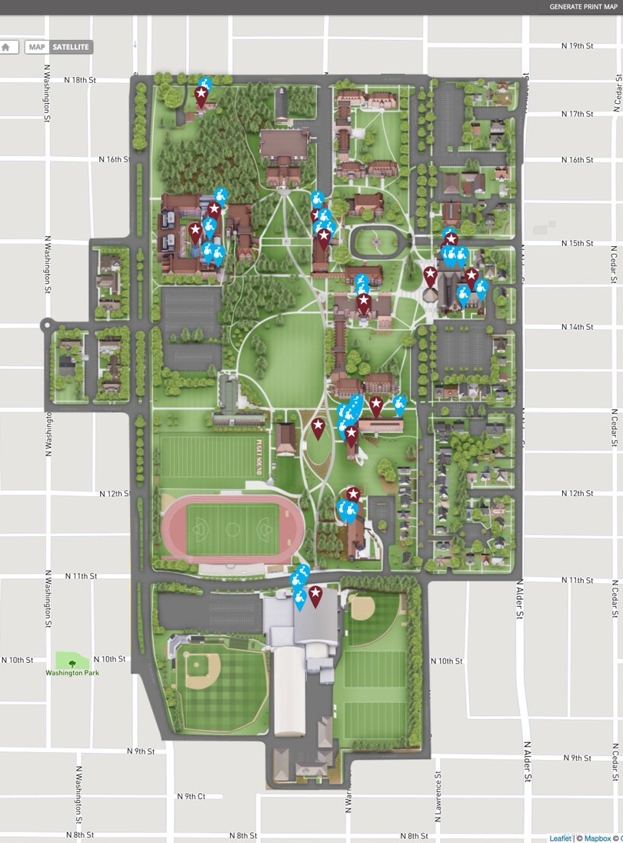
We are located on the traditional homelands of the Puyallup Tribe. The Puyallup people have lived on and stewarded these lands since the beginning of time, and continue to do so today.

Slide 3
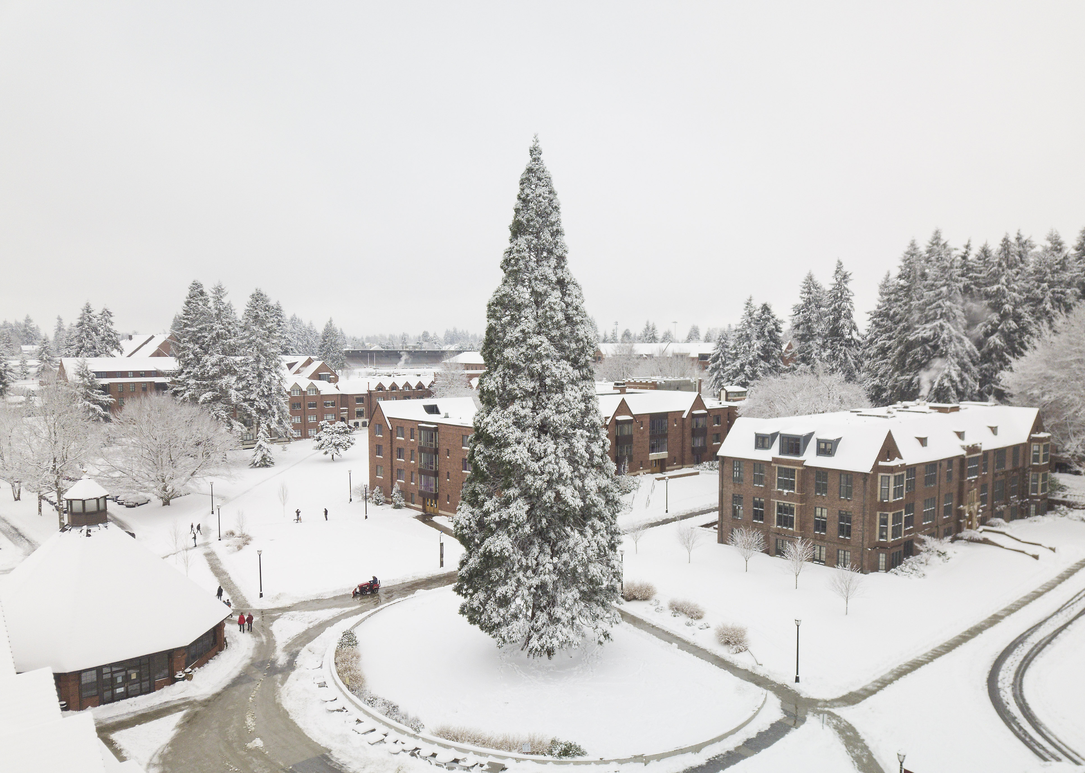
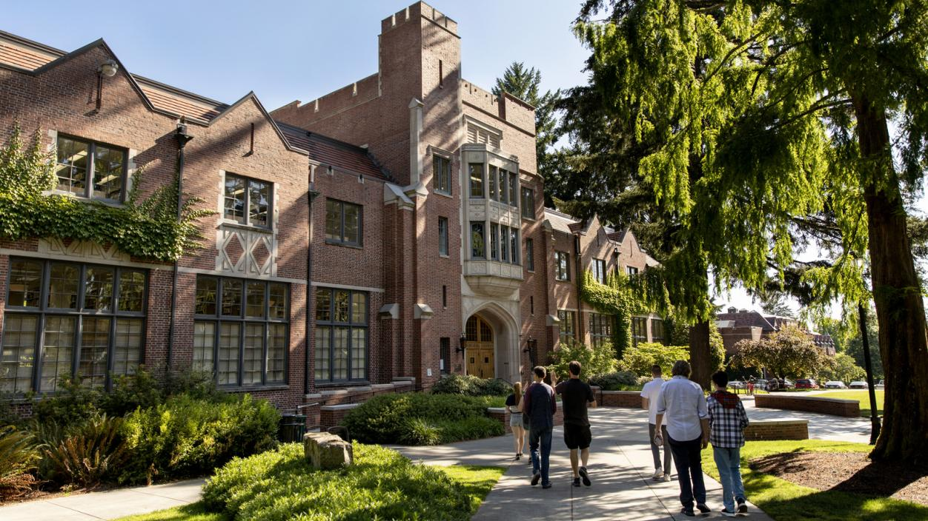
We are located on the traditional homelands of the Puyallup Tribe. The Puyallup people have lived on and stewarded these lands since the beginning of time, and continue to do so today. beyond.

Slide 4
We are located on the traditional homelands of the Puyallup Tribe. The Puyallup people have lived on and stewarded these lands since the beginning of time, and continue to do so today. beyond.

Slide 5
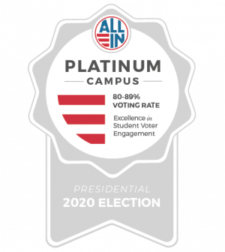
Top 10 Peace Corps Producing Institutions
Leading national institution for women in STEM
Tacoma, Washington--best college towns
KUPS 90.1--top 15 college radio stations

Slide 6
1 of 40
11:1
100+
90%
colleges included in Colleges that Change Lives
student-to-faculty ratio
study abroad programs in more than 40 countries
full-time, undergraduate faculty who hold terminal degrees in their field
50+
23
200+
2 hours
areas of study including a renowned School of Music and an innovative Business and Leadership Program
NCAA Division III men’s and women’s athletic teams
national scholarships since 2001 including Fulbright, Rhodes, Goldwater, Watson, and National Science Foundation
away from mountains, beaches, two national parks, and multiple wilderness areas
2,000
300
27%
100+
undergraduates from 46 states and 10 countries
graduate students
identify as students of color
wide-ranging organizations and clubs including fraternities and sororities
Notes:
Use this fact sheet as a recap and highlight all the they have heard today.

Slide 7
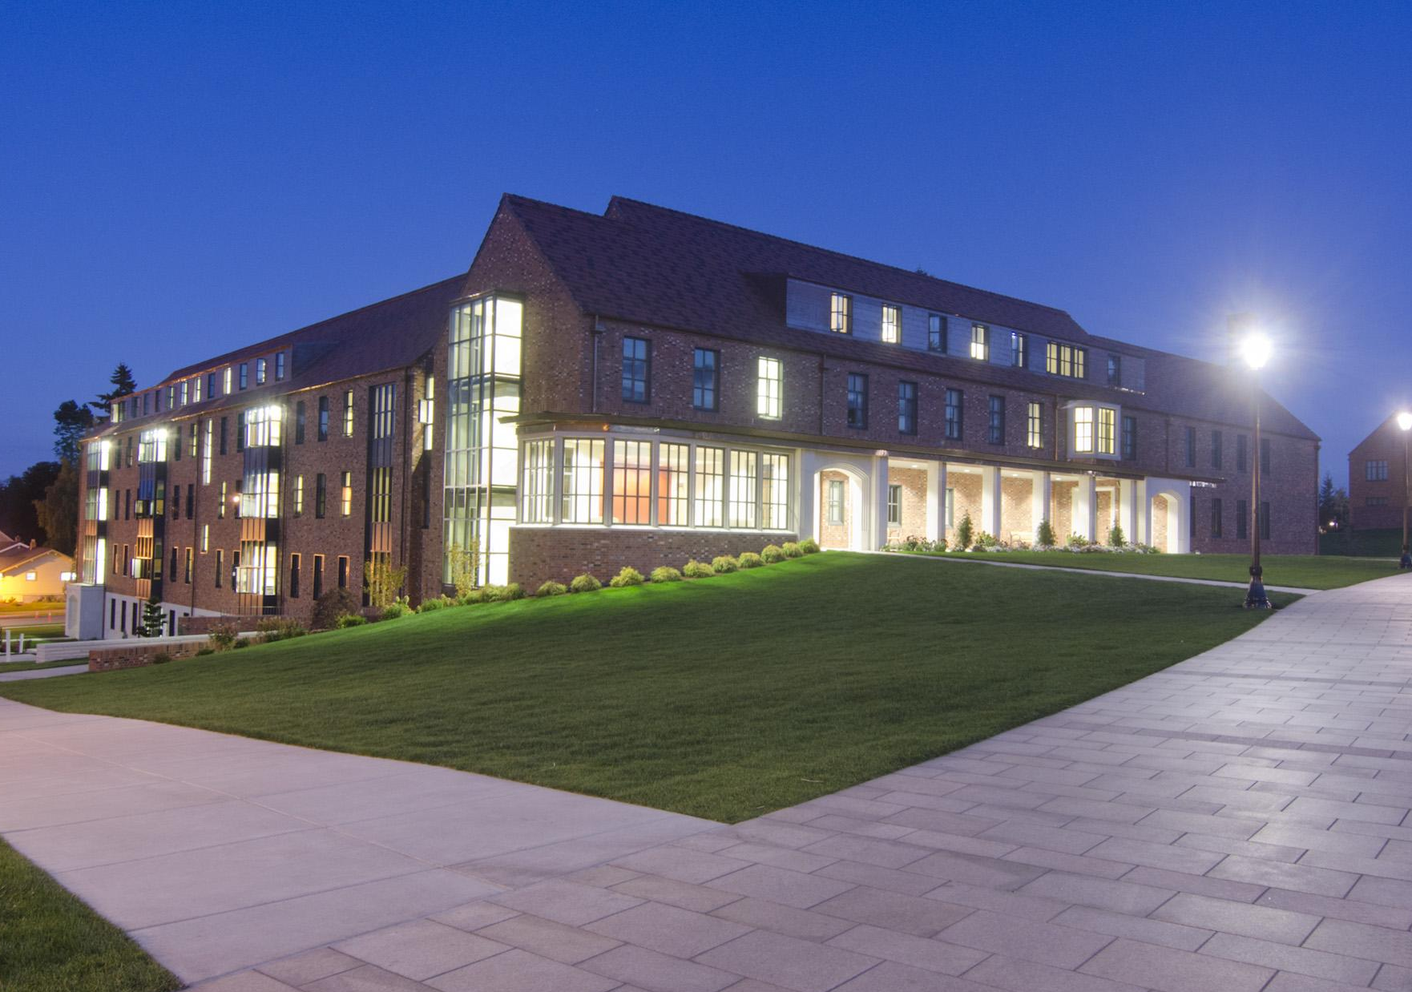
UNDERGRADUATE liberal arts and sciences areas:
Schools of Education, Business & Leadership, and Music
Sciences and health sciences
Cultures and languages, including Asian Studies, Chinese and Japanese
Humanities and Arts, including digital and studio art, and theatre
Globally-focused Social Sciences
GRADUATE programs:
Counseling (M.Ed.)
Education (M.A.T.)
Occupational Therapy (MSOT and OTD)
Physical Therapy (DPT)
Public Health (MPH)

Slide 8
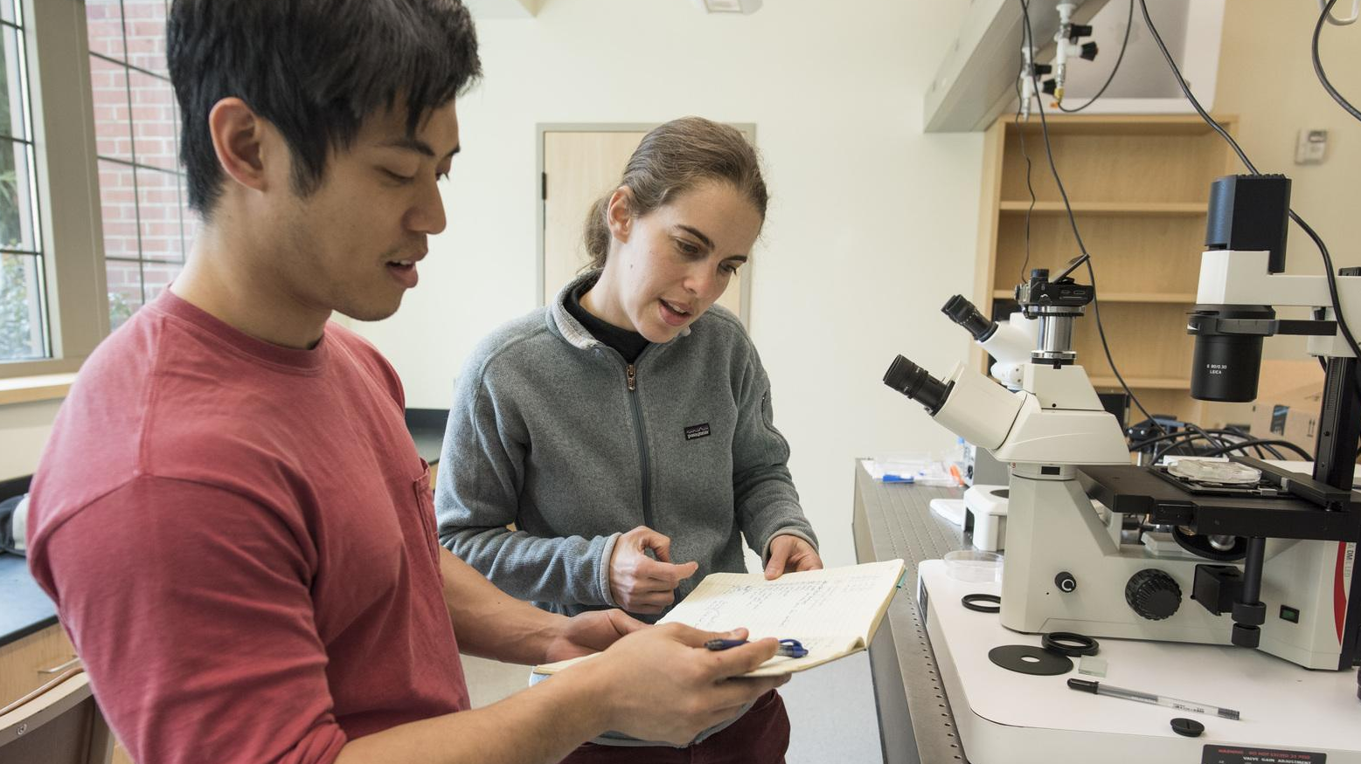
11:1
17
0
student-to-
faculty ratio
average class size
graduate
instructors

Slide 9
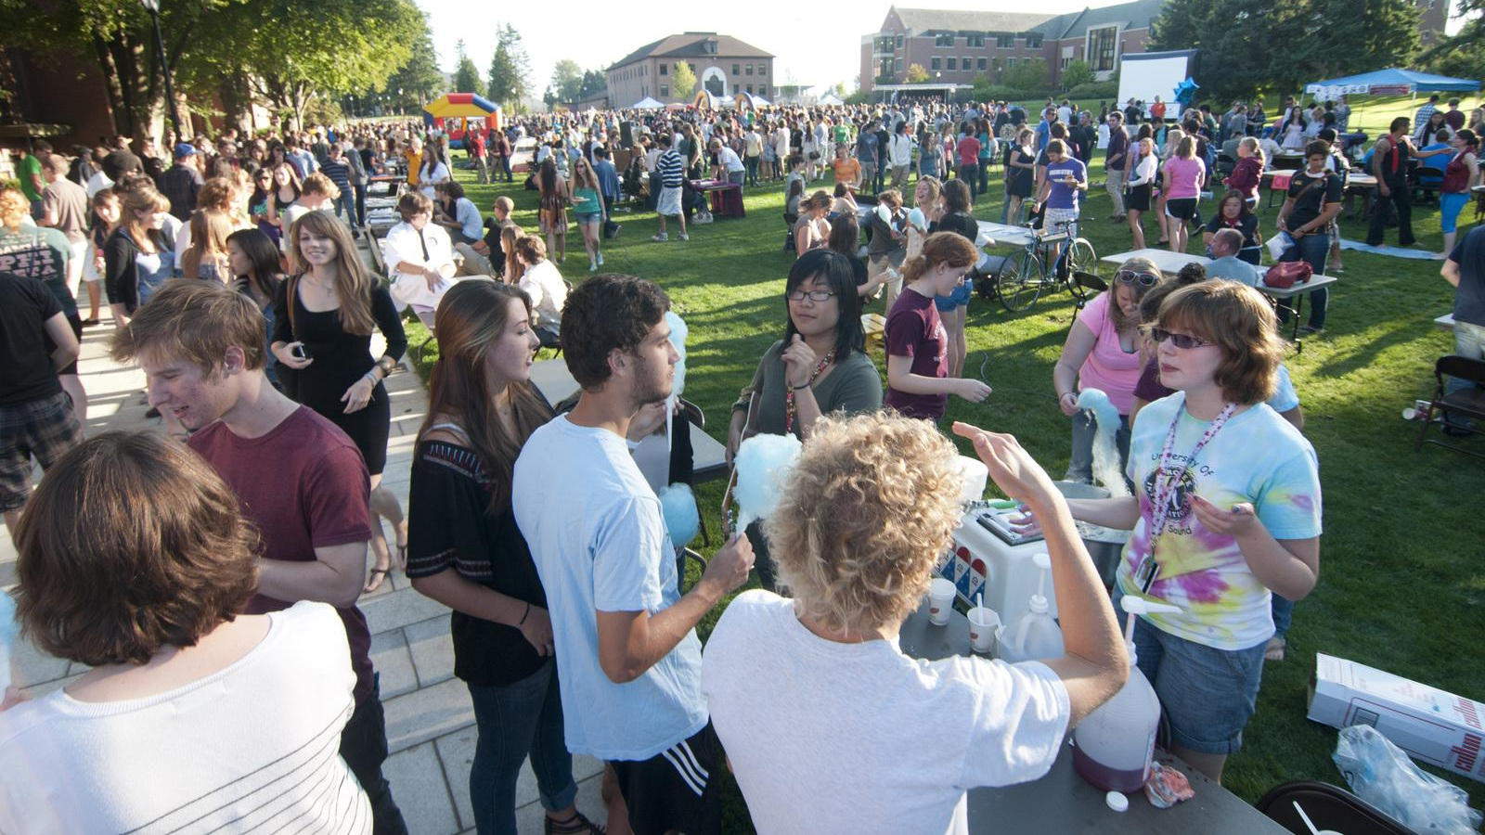
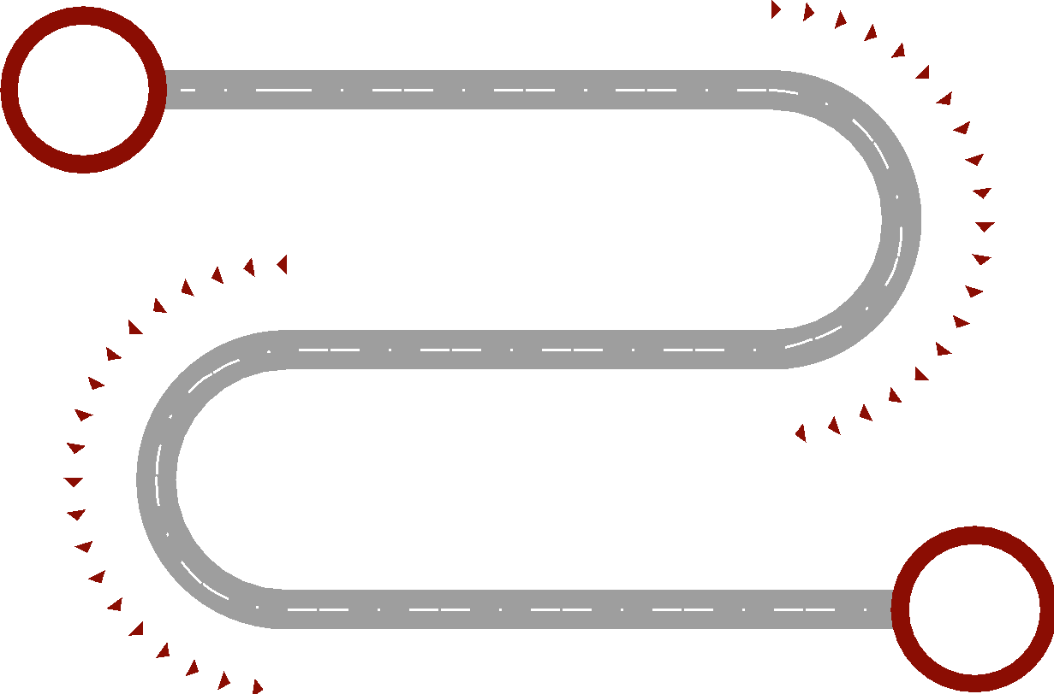
Experiential Learning
MENTORSHIP
INTERNSHIPS
STUDY ABROAD AND STUDY AWAY
RESEARCH, SCHOLARSHIP, AND CREATIVE WORK
COMMUNITY PROJECTS

Slide 10
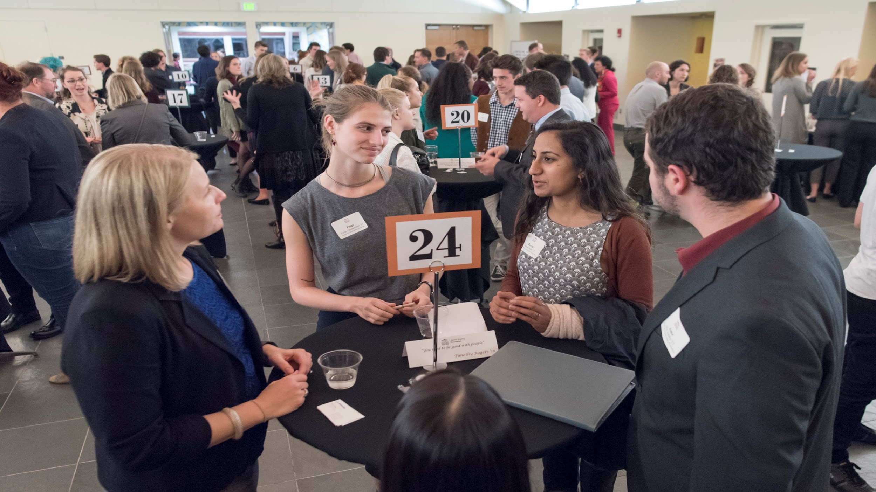
Top
80%
90%
7%
medical school
acceptance
rate
law school
acceptance
rate
producer of
doctorates

Slide 11
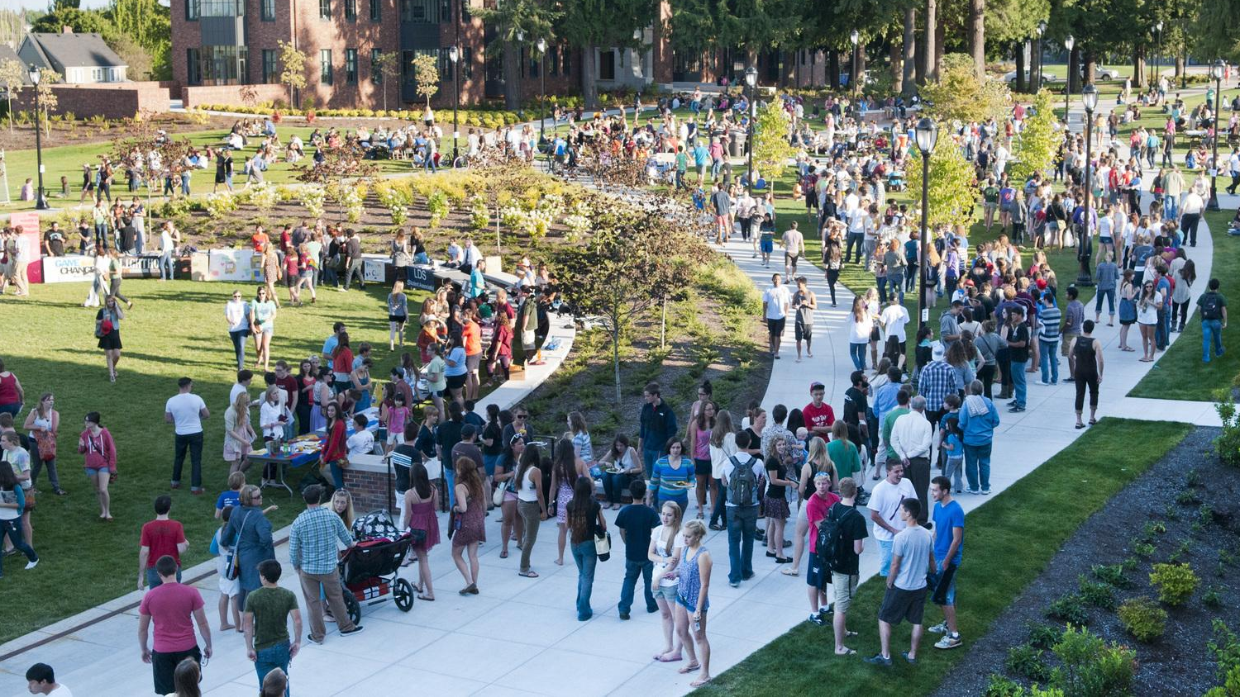
Global Connections

Slide 12
100
More than
study abroad programs
With opportunities in over 40 countries on six continents

Slide 13
College Tour

Slide 14
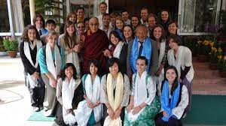
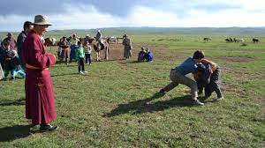
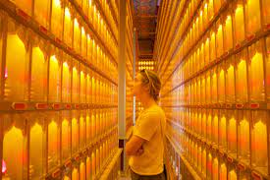
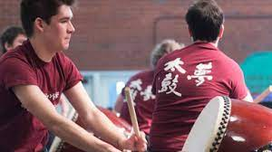
50th Anniversary

Slide 15
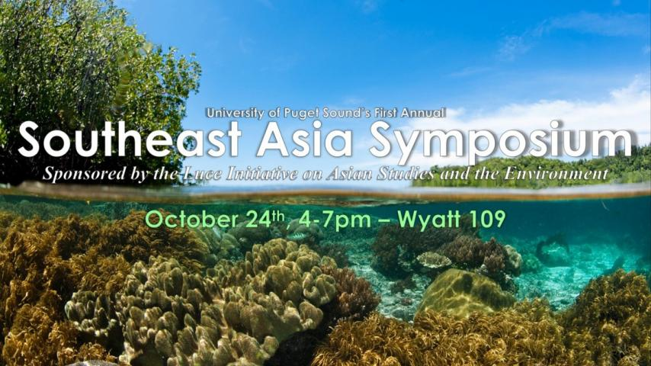

Slide 16
