Slide 1


Slide 2

NYU Shanghai Strengths

Slide 3
Mission
Cosmopolitan Faculty, Students and Vision
Experimental Liberal Arts
All Students Outside of Comfort Zone
Ability to Recruit Local and International Talent for Faculty and Staff

Slide 4
Structural
Strong Government Partner
Supportive University Partners
Research Institutes
Graduate Programs
Residential Campus

Slide 5
Location
City of Shanghai
Large Mother Ship in New York City
NYU Global Network
Go Local

Slide 6
People
Diverse and Talented faculty
Highly Selective Admissions
8 to 1 Student to Faculty Ratio
Hardworking and Dedicated Local Staff
Goldilocks Size

Slide 7
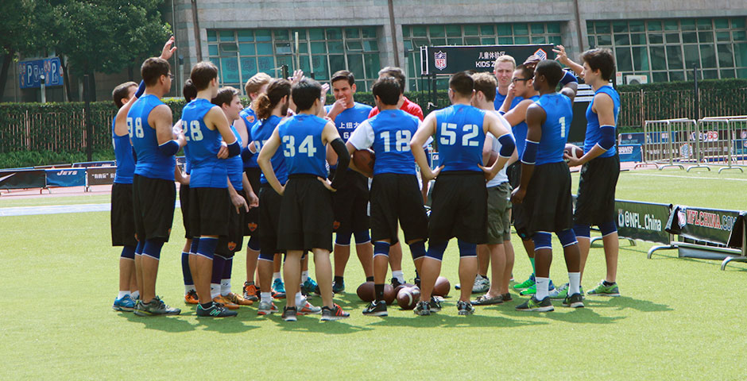
Liberal Arts at NYU Shanghai

Slide 8
Founding Principles
Liberal Arts Education with an emphasis in X
Business, Engineering, and Liberal Arts in small campus
China focused Global Perspective
Not in Major until end of Sophomore Year

Slide 9
Goals and Outcomes
Global Citizens
Critical Inquiry
No Topic Off Limits
Go beyond Agree to disagree
Community Engaged Learning

Slide 10
Curricular Requirements
Core Classes – GPS, WAI, POH
Distribution Classes – IPC (2), STS, ED, AT, QR
Language - EAP (2), Chinese (4)
Junior Year Study Away

Slide 11
Complementary Student Experiences
Research
Cosmopolitan Student Body
Roommate Pairings
Meta Curriculum
Sports, Clubs, Activities

Slide 12

Challenges Facing NYU Shanghai

Slide 13
Challenges for Faculty
Dual and dueling assessment and accreditation
Faculty Staying Connected to Field
Perceived Restrictions on Academic Freedom
Real Limitations on Free Speech
Self-censorship

Slide 14
Teaching Challenges
No Comfort Zone
Textbooks
Different Academic Preparation and Experiences of students and Faculty
75% ESL Student Body
Magnetic Attraction of New York City

Slide 15
Geo-Political Challenges
Cosmopolitan in a Nationalist World
Anti-China in US
Anti-US in China
High costs and limited financial aid

Slide 16
Mobility Challenges
Recruiting and retaining international faculty, staff, and students
Visas
Covid – attrition of internationals
Covid - stranded in Global Network
Travel Restrictions

Slide 17
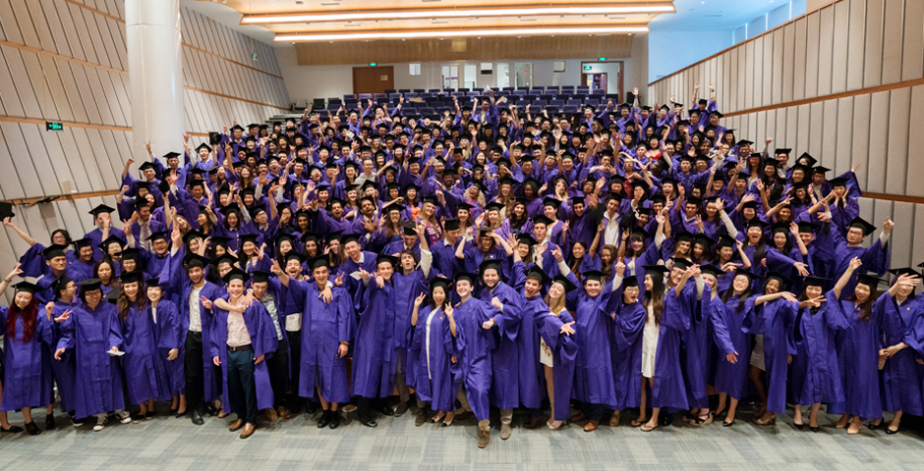
Questions

