Slide 1
Notes:
Discover Quest (2007 – 2017)
https://www.youtube.com/watch?v=MCF1-diNMfQ
Discover Quest Student (Recent)
https://www.youtube.com/watch?v=MCF1-diNMfQ

Slide 2
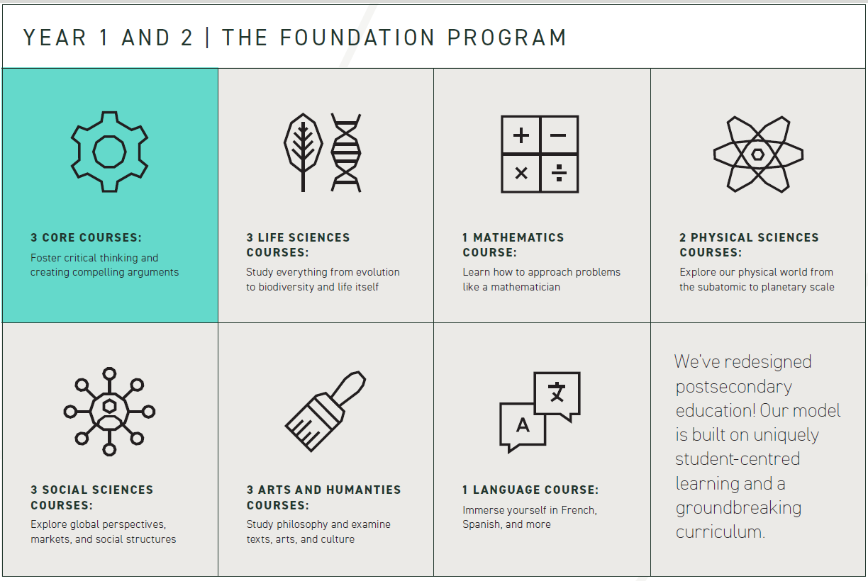
Bachelor of Arts and Sciences
Notes:
Discover Quest (2007 – 2017)
https://www.youtube.com/watch?v=MCF1-diNMfQ
Discover Quest Student (Recent)
https://www.youtube.com/watch?v=MCF1-diNMfQ

Slide 3
The ‘Block’
Notes:
Discover Quest (2007 – 2017)
https://www.youtube.com/watch?v=MCF1-diNMfQ
Discover Quest Student (Recent)
https://www.youtube.com/watch?v=MCF1-diNMfQ

Slide 4
Challenges & Inspirations
Notes:
Discover Quest (2007 – 2017)
https://www.youtube.com/watch?v=MCF1-diNMfQ
Discover Quest Student (Recent)
https://www.youtube.com/watch?v=MCF1-diNMfQ

Slide 5
How Quest can help PALAC
Notes:
Discover Quest (2007 – 2017)
https://www.youtube.com/watch?v=MCF1-diNMfQ
Discover Quest Student (Recent)
https://www.youtube.com/watch?v=MCF1-diNMfQ

Slide 6
How PALAC can help Quest
Notes:
Discover Quest (2007 – 2017)
https://www.youtube.com/watch?v=MCF1-diNMfQ
Discover Quest Student (Recent)
https://www.youtube.com/watch?v=MCF1-diNMfQ

