Slide 1
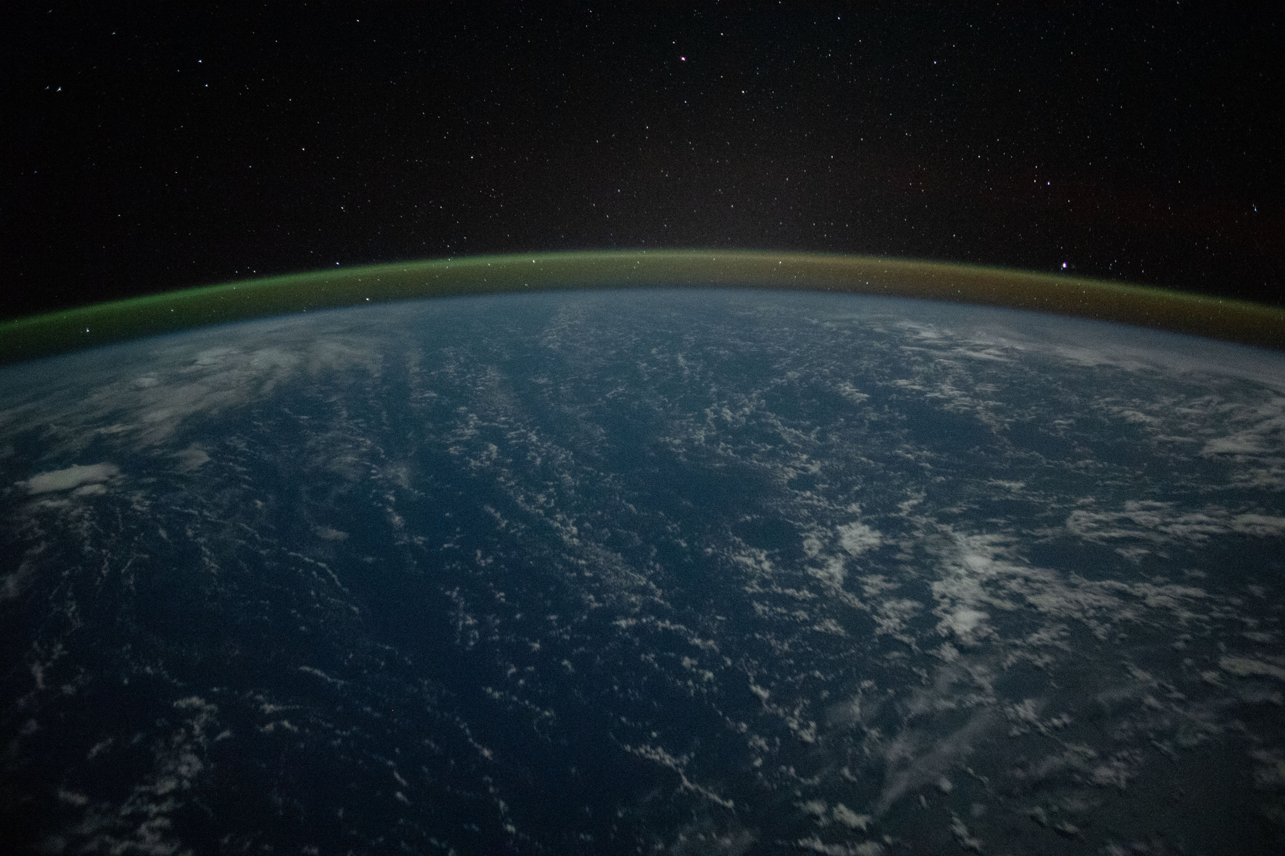
Climate Change and the Pacific
George Busenberg
Associate Professor of Environmental Management and Policy
Soka University of America

Slide 4
Mauna Loa CO₂ Record (Keeling Curve)
Credit: Scripps CO₂ Program, Scripps Institution of Oceanography

Slide 5
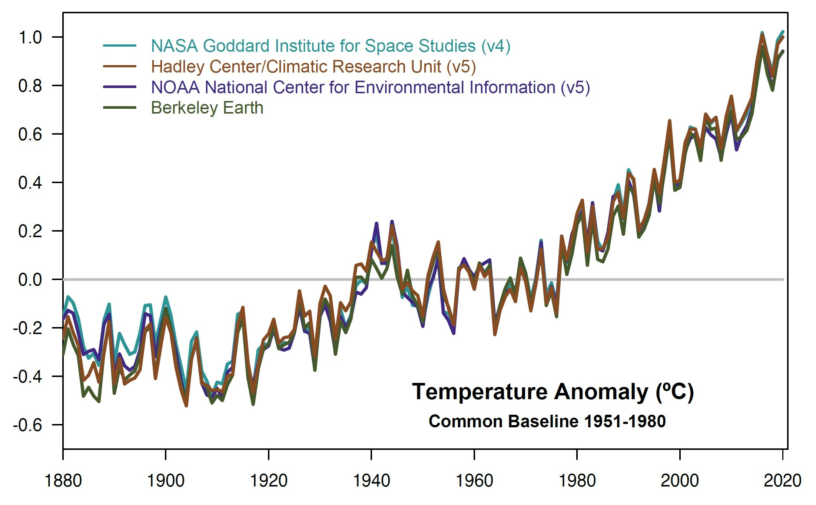
Global Temperature Record

Slide 6
The Future of the Pacific
Climate change, ocean acidification, and rising seas are magnifying hazards across the Pacific Basin: storms, wildfires, heat waves, droughts, floods, displacement, disease, and food insecurity.
The responsible management of these hazards will require sustained policy efforts in climate change mitigation and adaptation.

Slide 7
Pacific Environmental Policy
The national and international policies designed to protect the environment of the Pacific have not yet proven equal to the scale of transnational environmental challenges such as climate change.
Climate change may constitute the single greatest threat to the environment and economies of the Pacific Basin.

Slide 8
Typhoon in the Pacific (2015)

Slide 9
Wildfires in Australia (2019-2020)

Slide 10
Fishing offshore of the Korean Peninsula (2021)

Slide 11
The Role of Liberal Arts Education
Environmental issues are inherently complex, and the management of those issues should therefore be well-informed.
Liberal arts institutions excel at instruction, and now have the technological means to share essential elements of environmental education with a global audience.

Slide 12
Pacific Environmental Project
Proposed educational website designed to greatly expand the reach of accessible environmental knowledge across the world.
The aim of the website would be to provide an organized framework of understanding with clear and concise expert explanations of critical environmental issues such as climate change adaptation and mitigation.

Slide 13
Global Environmental Education
The website would include references and links to key resources on the environment, such as academic publications.
The website would also list institutions and programs offering relevant educational opportunities for prospective students.

Slide 14
Visualization
Environmental processes often occur at scales that are best understood when visualized using space-age technologies.
NASA has posted thousands of images of Earth from space that are in the public domain, creating a vast resource of orbital visualizations available for the project.

Slide 15
Orbital Imagery Resources
Pacific images: NASA/NOAA Deep Space Climate Observatory EPIC camera (2022).
Pacific Typhoon Image ISS043-E-79351 courtesy of the Earth Science and Remote Sensing Unit, NASA Johnson Space Center (2015).
Other images: NASA Earth Observatory.

Slide 16
Benefits
Expand the global visibility of PALAC.
Increase the prominence of liberal arts education in the global community.
Encourage students to pursue education and careers in the environmental field.
Support instructors and students.

Slide 17
Conclusion
The Pacific Environmental Project would combine teaching, research, and outreach into a single system designed to expand environmental understanding worldwide.
The project would aim to strengthen the connections between instructors, students, and the world community through the cost-effective application of high technology.

