Slide 1
Asia in the Liberal ARts

Slide 2
1st Year serminar: Zen insights and oversights
What role does Buddhism play in Black America?
What tools can Buddhism provide to mental health professionals?
What are some psychological benefits of meditation?
What are some physiological benefits of meditation?
What role do ghosts play in Buddhism?
What is the women’s vegetarian sect of Buddhism in Taiwan?
How have Buddhism and Tibet been related historically?
What are some ways that Buddhism has been commodified in the U.S.?
What is the discourse regarding psychedelics in Buddhist circles?
How does Buddhist music help to transmit the dharma?
How have non-binary gender identities been represented in Buddhist myth and iconography?

Slide 3
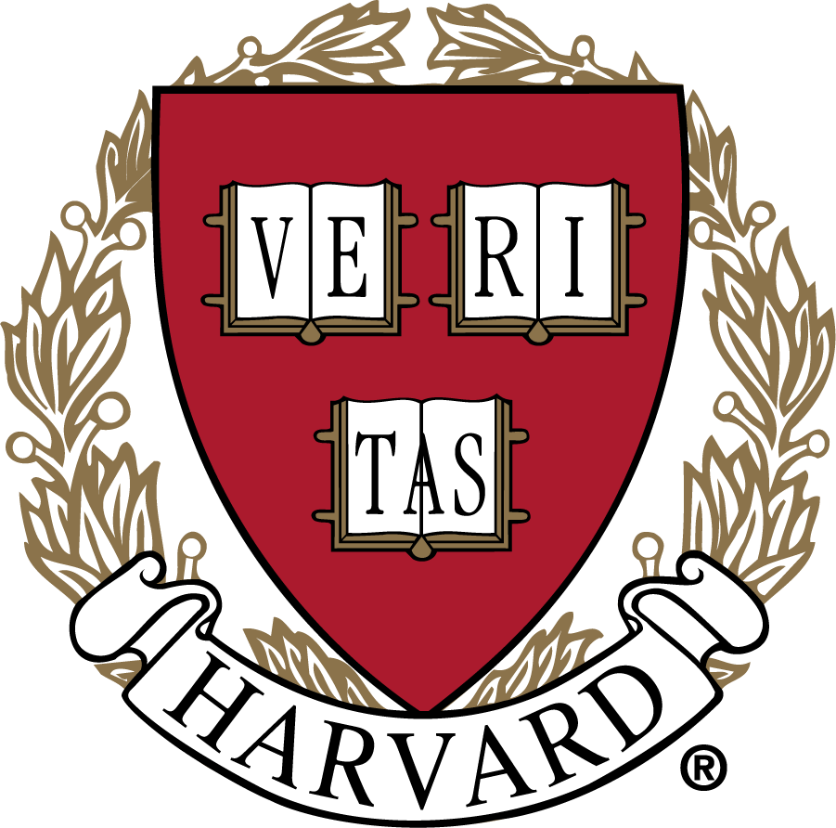

Latin and Greek Mottos:
“Truth” and “To the Heights”

Slide 4
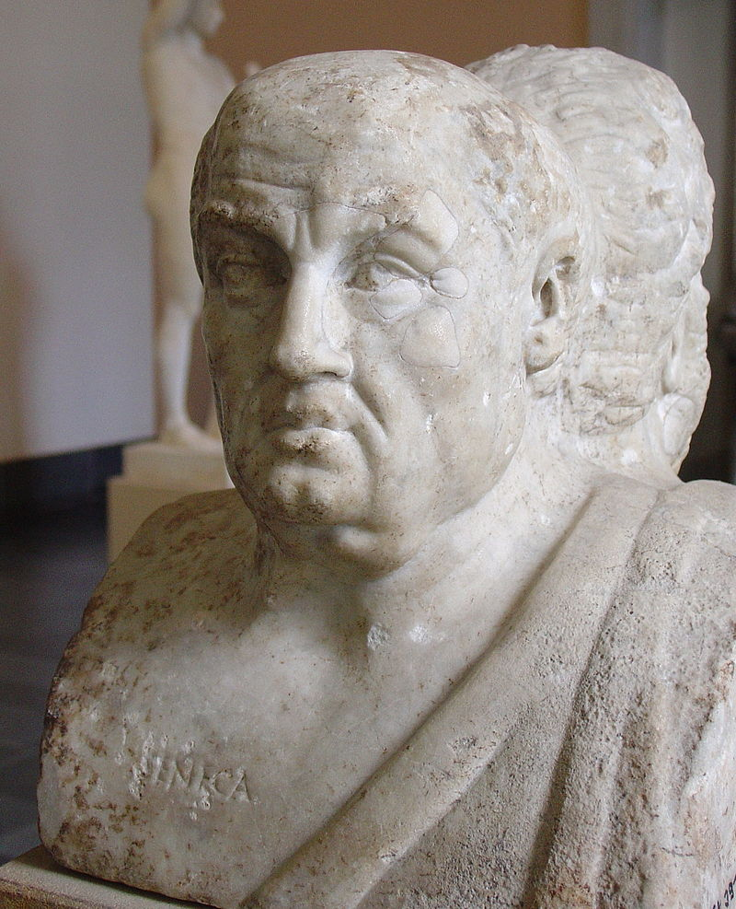
“you can’t go wrong with Seneca”

Slide 5
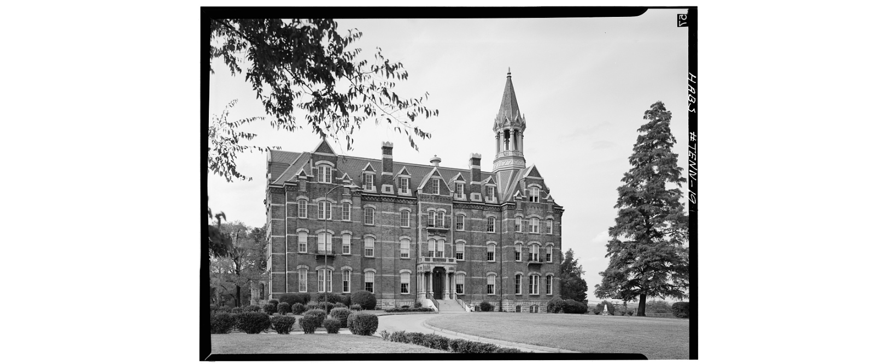
W.E.B. Dubois & Fisk University

Slide 6
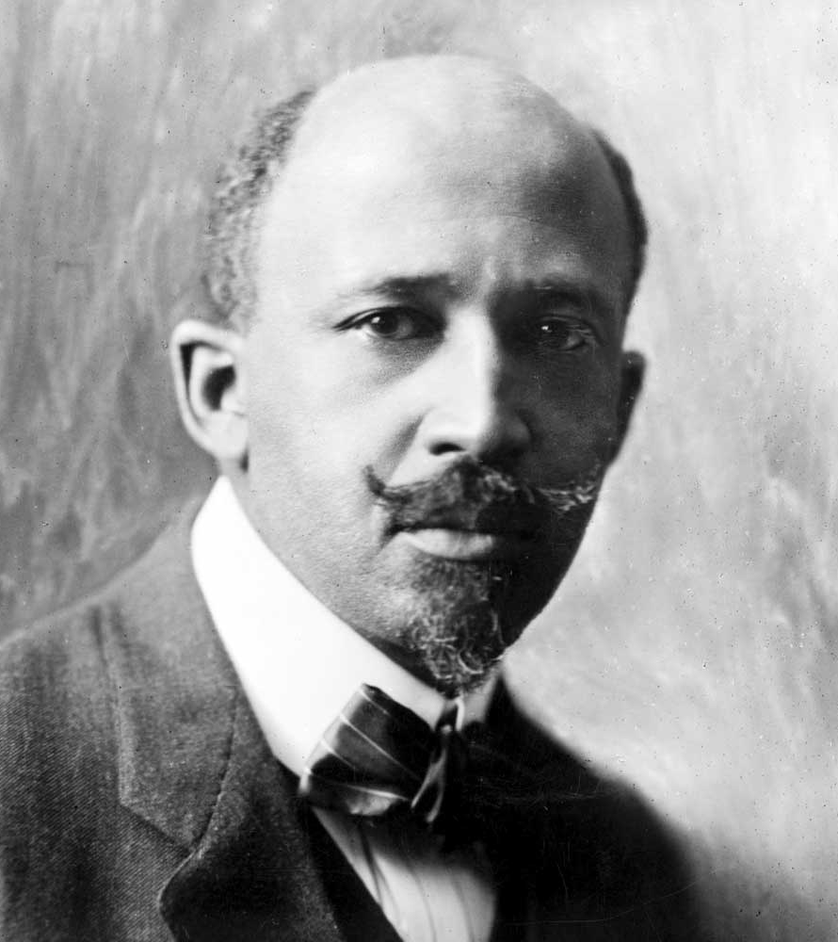
W.E.B. DUBOIS
“EDUCATION MUST NOT SIMPLY TEACH WORK;
EDUCATION MUST TEACH LIFE”

Slide 7
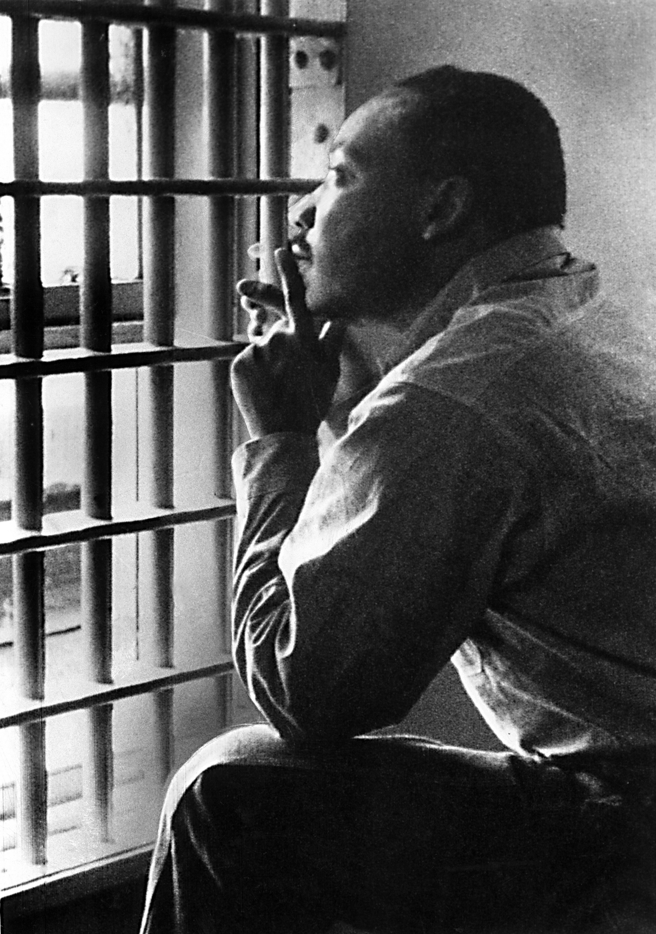
Dr. Martin Luther King’s “letter from a Birmingham jail”
Socrates, Jesus, Paul, Augustine, Aquinas, Martin Luther, Thomas Jefferson, Abraham Lincoln, TS Eliot, Reinhold Niebuhr, Martin Buber, and Paul Tillich . . .

Slide 8
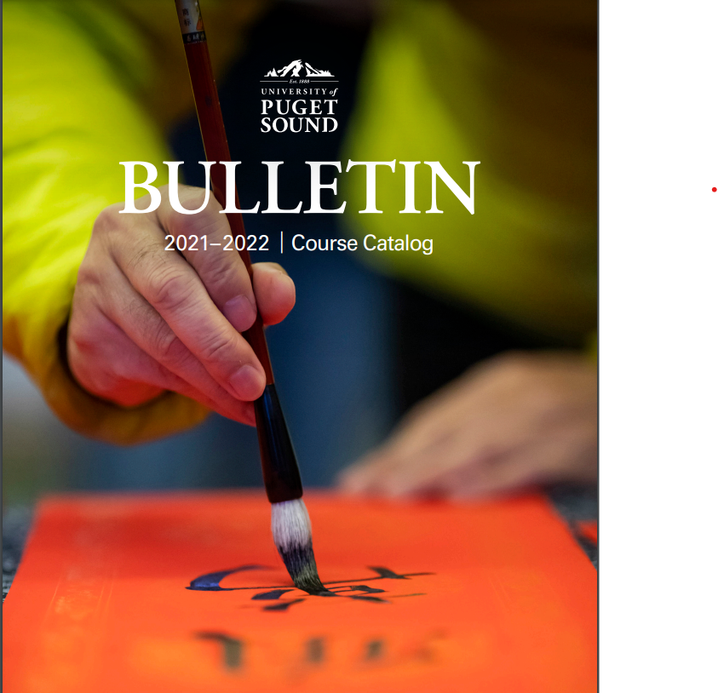
Asia in the Liberal arts

Slide 9
The Zhuangzi: Butterfly Dream
Once Zhuang Zhou dreamed he was a butterfly, flitting and fluttering about, happy with himself and doing as he pleased. He didn’t know that he was Zhuang Zhou. Suddenly he woke up and there he was, solid and unmistakable. But he didn’t know if he was Zhuang Zhou who had dreamt he was a butterfly, or a butterfly who was dreaming that he was [now] Zhuang Zhou …

Slide 10
The Zhuangzi:
Owls crave mice
Humans eat the flesh of hay-fed beasts, deer eat grass, and owls and crows crave mice; which of these has the proper sense of taste?

Slide 11
The Daodejing
Devotion to learning means increasing day by day;
Devotion to the Way (Dao) means decreasing day by day.

Slide 12
The daodejing
When everyone in the world knows beauty as beauty, ugliness appears . . .

Slide 13
The heart sutra
The bodhisattva Avalokitesvara, while moving through the course of Perfect Understanding, shed light on the five skandhas, and found them equally empty. After this penetration, they overcame all pain.

Slide 14
Basho’s death poem
Ill on a journey:
Dreams go hovering
Over withered fields

Slide 15
The practice of the past illuminates the present
稽古照今

Slide 16
Chinese religious Traditions
What does Du Wei-Ming mean when he speaks of “learning to be human?” Aren’t we born human? Is something lacking in us that we must develop? What are some “models for being human” you’ve encountered in the various classical and Confucian texts we’ve encountered? Are there any that you might wish to apply to your life as a human, or do you find them irrelevant, archaic, foreign, or possibly inhuman?”

Slide 17
Japanese religious traditions
Caring for the dead remains an important focus of Japanese religious life. At the same time, the nature and organization of rituals for the dead can be seen to change along with changes in society. To the student of Japanese religion, how do beliefs and practices regarding the dead illuminate social issues in the world of the living?

Slide 18
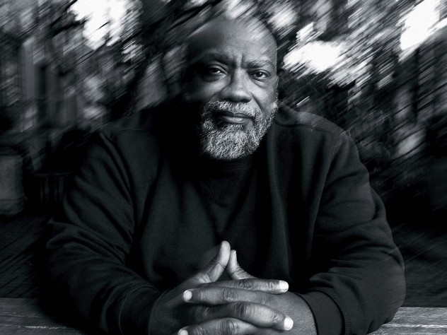
Fred Moten
“Being post medieval doctors in good standing, we bleed the university in order to keep alive what we would kill . . .”

Slide 19
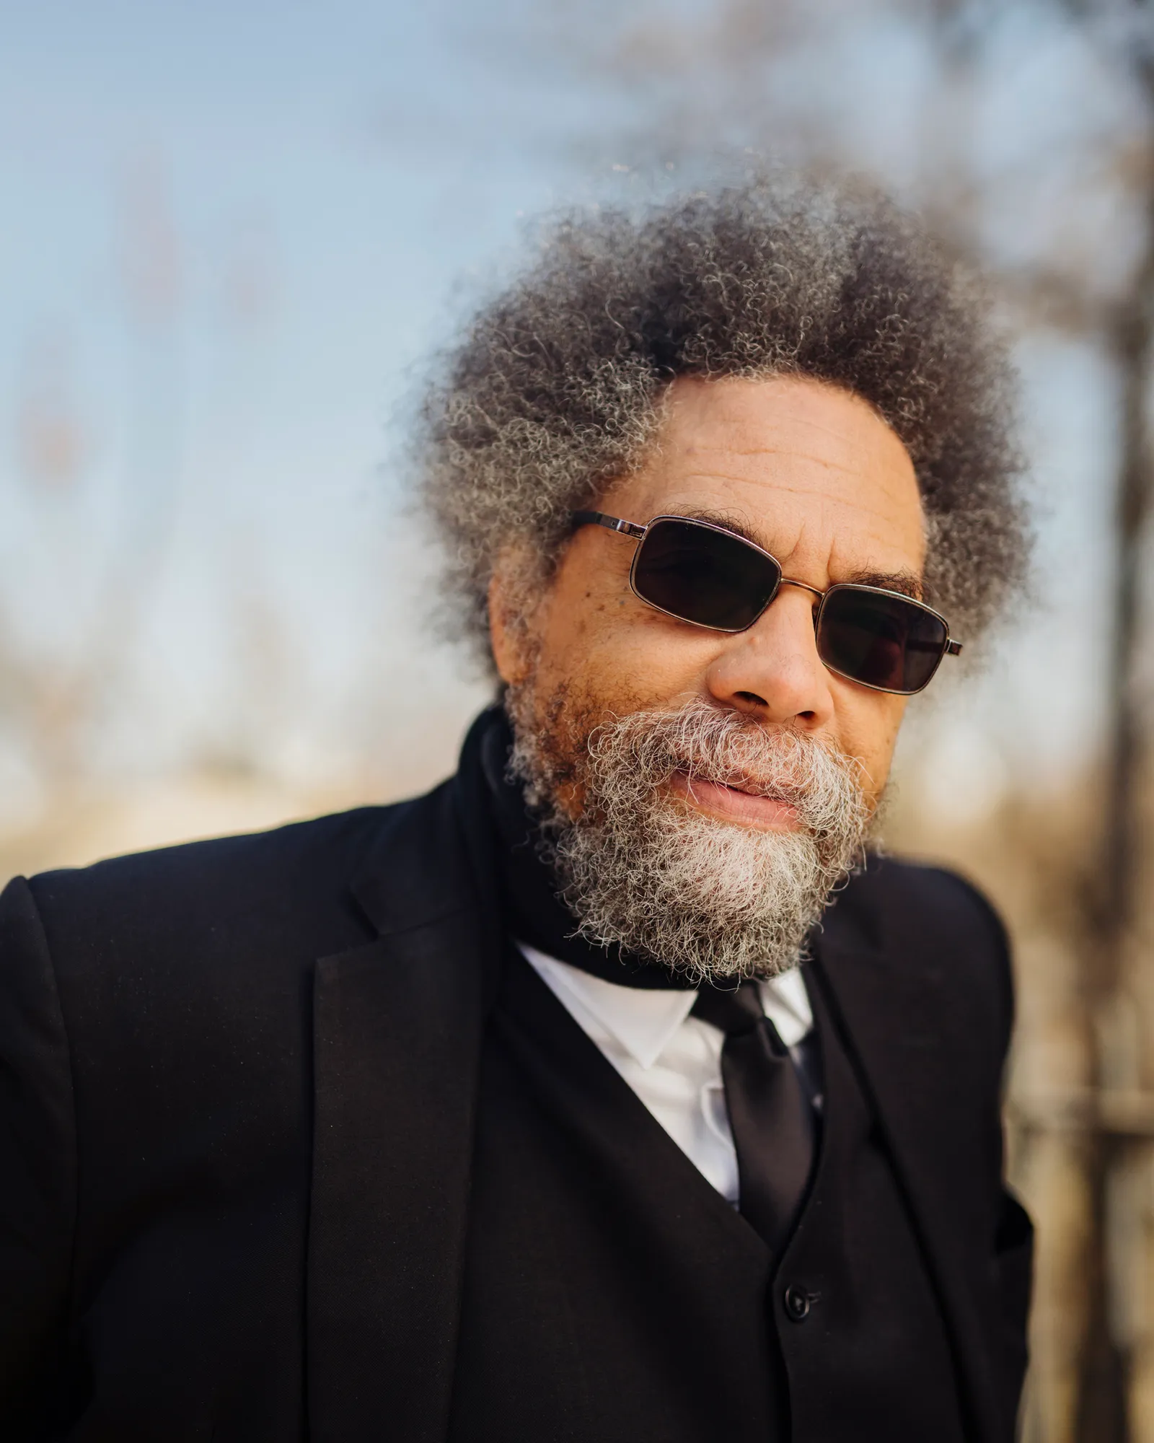
Cornell west
“The key is this: any racial, gender, or queer identity as a thinker should be rooted first and foremost in moral integrity and genuine solidarity with other struggling and suffering human beings & creatures.”

Slide 20
The Nei-Yeh
The vital essence of all things
It is this that brings them to life
It generates the five grains below
And becomes the constellated stars above
When flowing amid the heavens and the earth
We call it ghostly and numinous
When stored within the chests of human beings,
We call them sages.

