Slide 1
GLOBAL POMONA PROJECT
ENGAGING WITH THE WIDER WORLD—AT HOME AND ABROAD

Slide 2
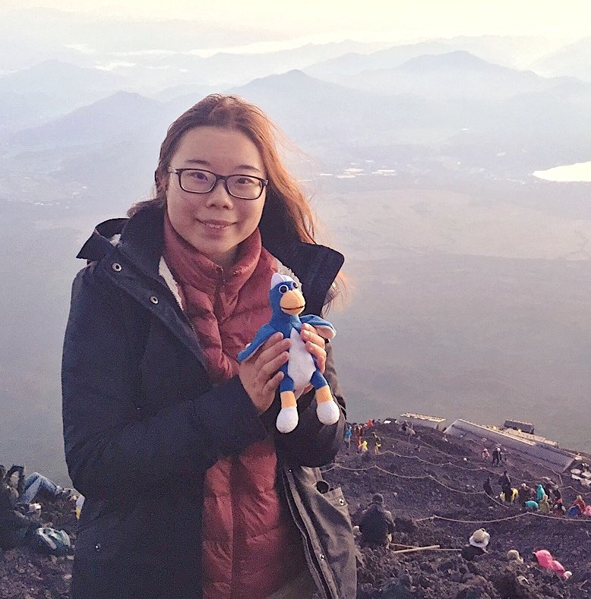
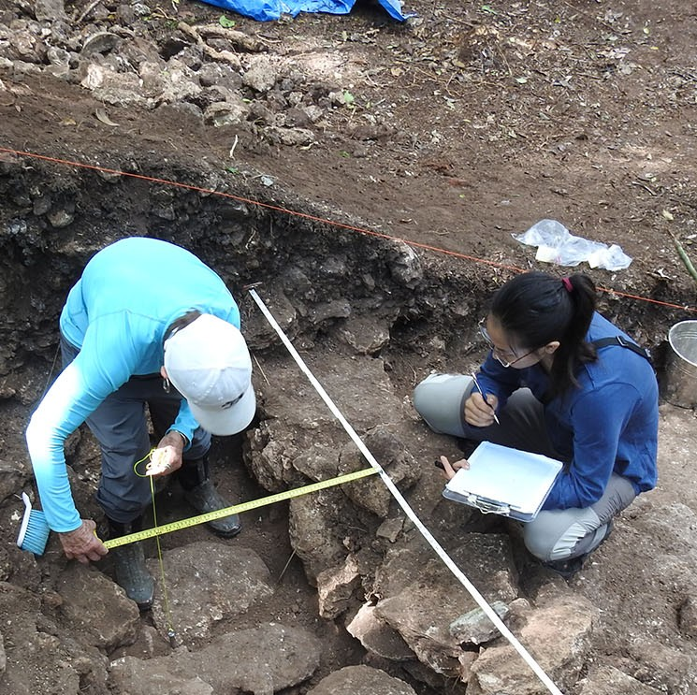
A PART OF OUR MISSION
Pomona College has sought to provide students with a global outlook and, over many decades, a wide range of internationally oriented programs have developed on campus.
International students comprise more of our student population; many students have family in other countries; more of our alumni live outside the U.S.
The world itself has changed, and Pomona must evolve with it.

Slide 3
INTERCULTURAL AGILITY
Bring Pomona College’s liberal arts education to life in ways that reach beyond disciplinary and national borders.
Better equip students to engage with people and organizations worldwide.

Slide 4
A GLOBAL EFFORT
Pomona must coordinate, connect and clarify our global efforts both within our own community and with partners around the world. The aim is to bring our liberal arts education to life in ways that reach beyond disciplinary and national borders and better equip our students to engage with people and organizations globally.

Slide 5
Building on the Strategic Vision, the Global Pomona Steering Group will develop and propose a strategy for
creating a stronger, more cohesive and intentional framework for global engagement through an extensive audit of Pomona’s wide-ranging international initiatives and focused conversations with stakeholders.

Slide 6
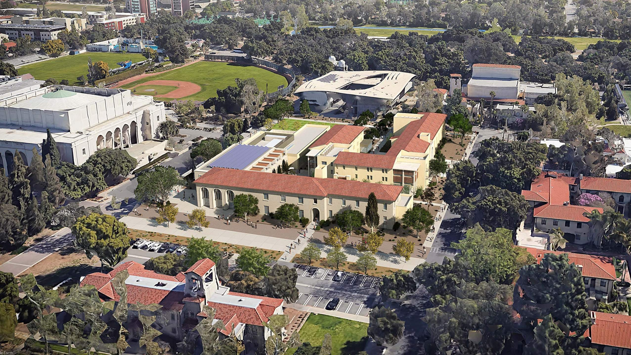
NEW CENTER FOR GLOBAL ENGAGEMENT
The Global Pomona Project will help guide development of the new Center for Global Engagement and implementation of the College’s Strategic Vision.

Slide 7
GLOBAL POMONA PROJECT GOALS
Every Pomona student will meaningfully engage with global learning, whether from abroad or here in the U.S.
Students will become more self-aware in their interactions across
cultures; acquire or demonstrate proficiency in a language other than English; cultivate intercultural attitudes
of respect, humility and curiosity; gain deeper knowledge of international
issues; and develop greater competence in navigating and engaging with a global society.
By the time they leave Pomona, students will be prepared to collaborate effectively with global partners to address the world’s most pressing problems.
New technologies will be deployed on campus to support global
learning, research, and collaborations; and this group will contribute to the conceptualization of new spaces to
support this work.

Slide 8
GLOBAL POMONA PROJECT GOALS
Our definition of global learning will evolve beyond something that occurs primarily outside U.S. borders as Pomona also develops a closer connection to international communities in Southern California, a center for immigrants from around the world.
Pomona will provide more consistent and coordinated opportunities for students and faculty to pursue research, experiential learning and other key elements of our academic mission and pedagogy within a global context.
This work will support key elements of the College’s Strategic Vision and provide a broad framework that aligns with the ongoing development of Pomona’s future global center and the transdisciplinary
programs that will take place there to address the grand
challenges facing the world.

Slide 9
CHARGE OF THE GLOBAL POMONA STEERING GROUP
Lead Pomona College to ensure that our community works together as a campus to develop and implement an integrated internationalization strategy;
Ignite inclusive campus-wide dialogue that guides discernment about the meaning of global learning and its role advancing Pomona College’s mission;
Establish strategies for increasing and deepening global learning opportunities for curricular and co-curricular programs while working in coordination with focused initiatives, including development of the global center;
Review and assess Pomona College’s current internationalization efforts;
Identify opportunities to bring together diversity, equity, and inclusion strategies; community engagement; and campus internationalization initiatives to strengthen and deepen connections between local and global community;
Prepare a draft of Pomona College’s first internationalization strategic plan, which will support implementation of the
College’s wider Strategic Vision.

Slide 11
LEADERSHIP TEAM
Seth Allen
Vice President for Strategy & Dean of Admissions and Financial Aid
Anne Dwyer
Associate Dean of the College and Associate Professor of German and Russian
Manisha Goel
Associate Professor of Economics
Nicole Desjardins Gowdy
Senior Director of International and Domestic Programs
Zayn Kassam
Associate Dean of the College and John Knox McLean Professor of Religious Studies
Mark Kendall
Chief Communications Officer
Fernando Lozano
Professor of Economics and Chair of the Faculty
Hector Sambolin, Jr.
Associate Dean for Academic Affairs, Academic Success and Assessment

Slide 12
STEERING GROUP
Sefa Aina
Associate Dean and Director of the Draper Center
Mietek Boduszyński
Associate Professor of Politics
Hazel Raja
Associate Dean and Senior Director of The Career Development Office
Shannon Randolph
Director of Global Social Impact, the Rick and Susan Sontag
Paul Cahill
Center for Collaborative Creativity
Associate Professor of Romance Languages and Literatures and_{• José Rodriguez}
Faculty Director of Oldenborg
Martina Ebert
Senior Director, Foundation Relations and Strategic Initiatives
Benjamin Keim
Associate Professor of Classics
Daniel Martínez
Professor of Biology
Jennifer Rachford
Director of Institutional Research
Vice President and Chief Information Officer
Rosalía Romero
Assistant Professor of Art History
Shahan Sanossian
Assistant Vice President, Advancement Communications & Events
Yuqing Melanie Wu
Professor of Computer Science

Slide 13
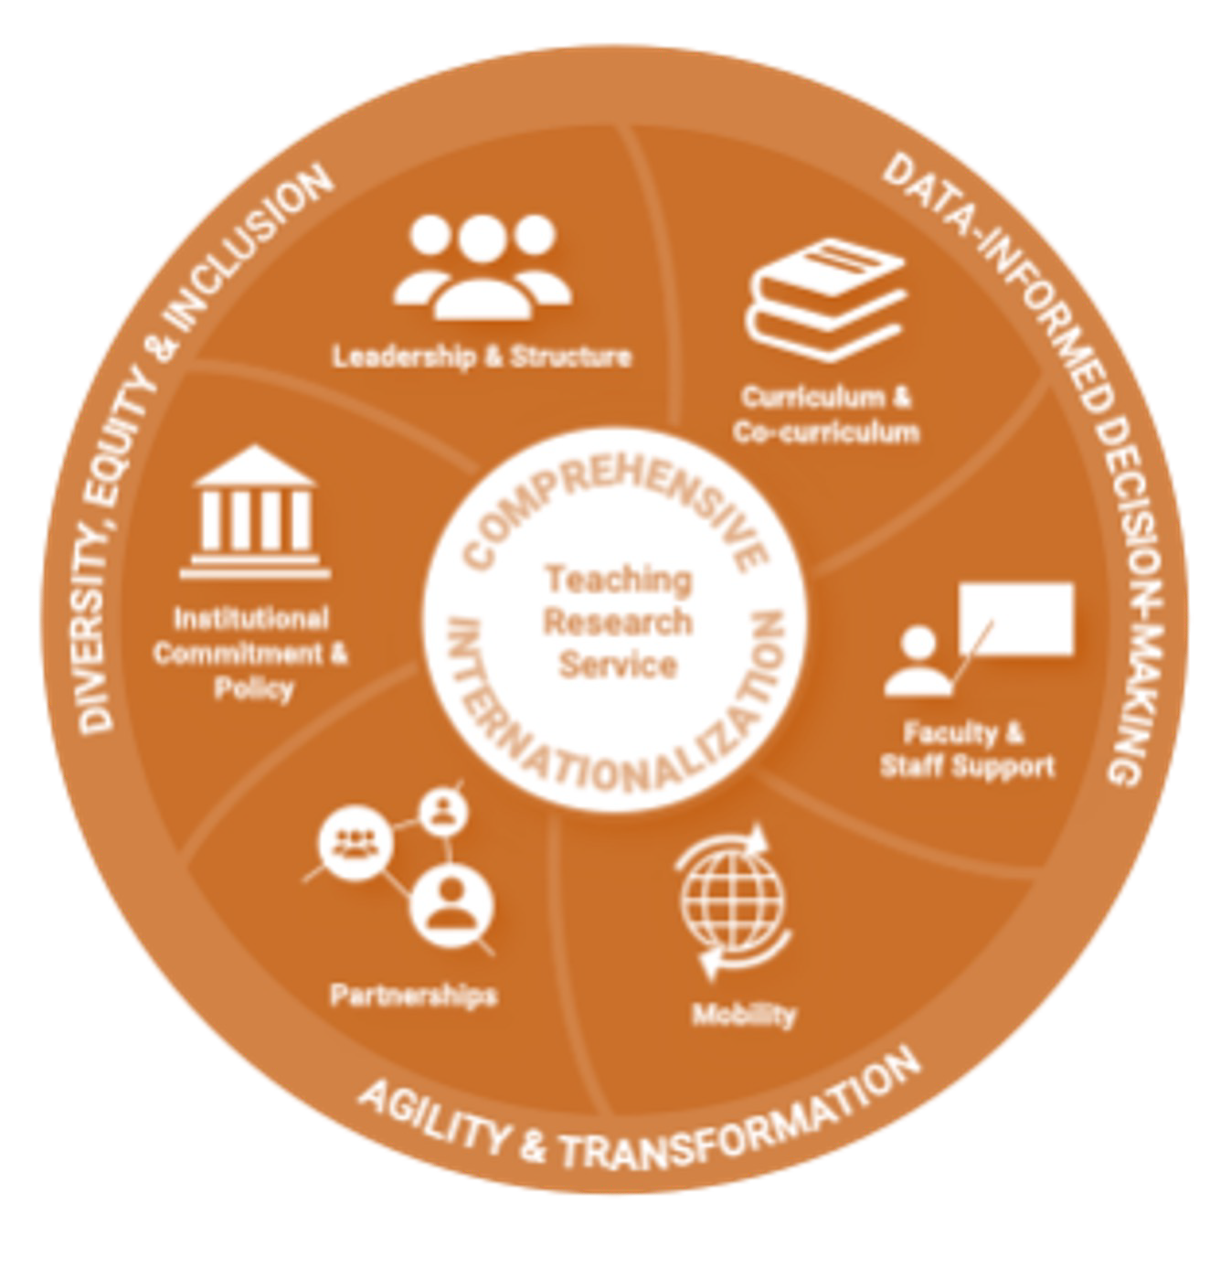
PARTNERSHIP WITH AMERICAN COUNCIL ON EDUCATION (ACE)
By Joining the ACE Internationalization Laboratory, the College is drawing on the experience and guidance of others as we create a pathway that will be uniquely Pomona.

Slide 14
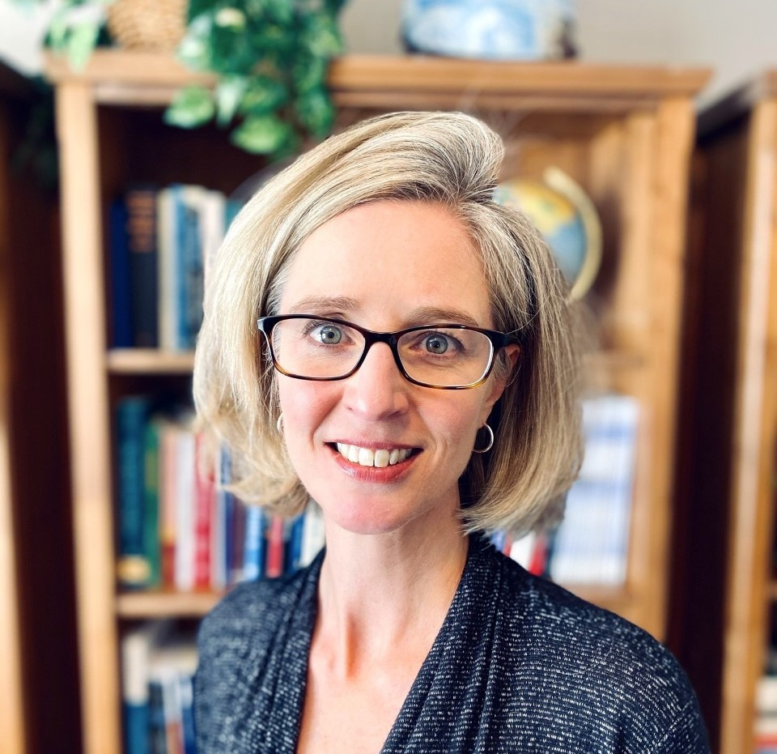
POMONA’S ACE LIAISON: KARA GODWIN
Kara Godwin is director of internationalization at the American Council on Education (ACE), where she leads the Internationalization Laboratory and contributes to ACE’s global research initiatives. She will serve as Pomona’s liaison during the process. She also is a research fellow at the Boston College Center for International Higher Education.
Godwin’s experience includes consulting and research for governments, NGOs and educational institutions on issues of internationalization, strategic policy, interdisciplinary and liberal arts education, evaluation and learning/teaching/curriculum. Her clients included Duke/Duke Kunshan University, Olin College of Engineering and Soka University.
A Pell Grant recipient and first-generation college graduate, Godwin earned her Ph.D. in comparative and international education from Boston College, an M.S. in higher education and social policy from Northwestern and a B.A. in international relations and English from Augustana College.

Slide 15
WHERE THE PROJECT STANDS
The project’s on-campus launch in February, with a visit from Kara Godwin, our ACE advisor, drew helpful insights from students, staff and faculty.
Our qualitative survey of faculty last month brought a strong response with more than 80 participants.
Right now, members of the steering group are beginning to analyze the data from the faculty survey.
To focus our work, the steering group created areas of subcommittee work: leadership, strategy and structure; curriculum and co-curriculum; partnerships and programs; supporting students, faculty and staff in their mobility.
In addition to the recent faculty survey, we are drawing on:
Previous reports and initiatives
Student focus group during project launch
Conversations with stakeholders. So far—mostly faculty, but also some students and staff; parent council; alumni focus group, trustees

Slide 16
WHERE THE PROJECT STANDS
May-June 2022: Planning for staff outreach over summer and student outreach early fall
July- August 2022: Data-gathering from staff and ongoing data analysis
September-October 2022: Data-gathering from students
December 2022: Plan and outline report
January 2023: Complete report
February-March 2023: Pomona team submits report to ACE peer review; ACE Advisor and two peer reviewers visit Pomona with our proposed timing the week of Feb 28-March 4.
April 2023: ACE final report submitted to Globalization Lab Leadership Team
May-June 2023: Plan implementation and next steps

Slide 17
FOOD FOR THOUGHT
Global learning is the process of diverse people collaboratively analyzing and addressing complex problems that transcend borders.
--Landorf et al., Making Global Learning Universal, 2018

Slide 18
GLOBAL POMONA PROJECT
ENGAGING WITH THE WIDER WORLD—AT HOME AND ABROAD

