Slide 1
PALAC
Launch Meeting
3 June 2022
Dr. Albert Chau
Vice-President (Teaching and Learning)

Slide 2


H
K
B
U
About
Founded in 1956 (as Hong Kong Baptist College)
Acquired university status and renamed as
Hong Kong Baptist University in 1994
2021)
Undergraduates: 7127
Postgraduates: 4819
Academic Staff: 1409
(as of 31 December 2021)

Slide 3
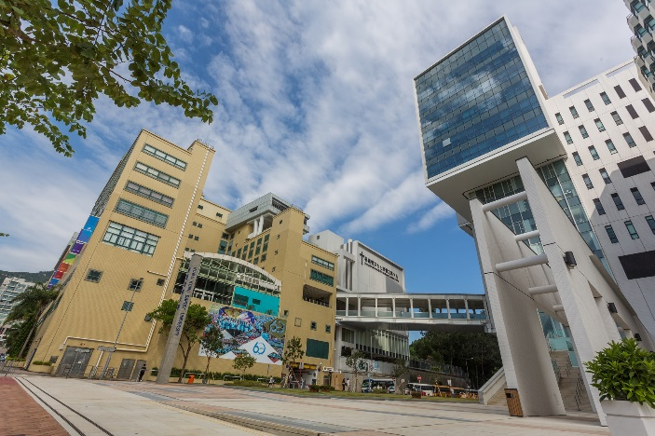
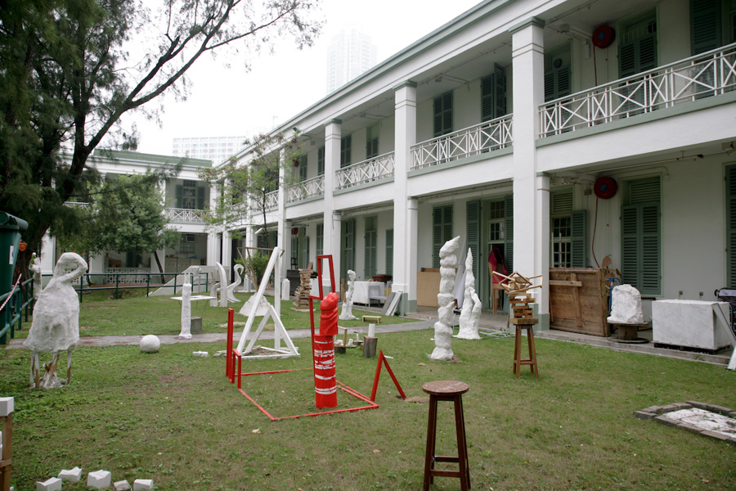
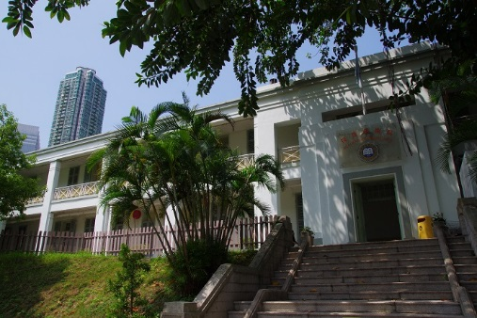
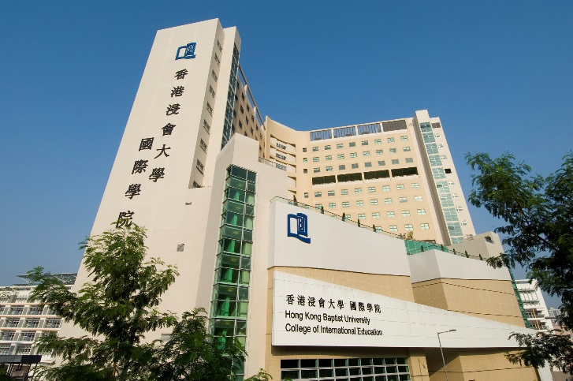
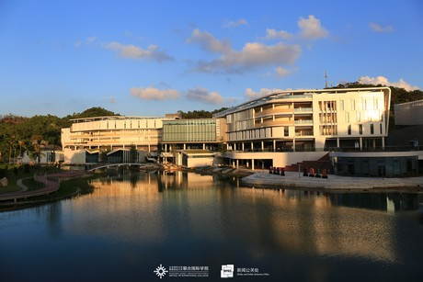
Campuses
Main Campus
Visual Arts Campus
School of
Continuing Education
UIC, Zhuhai Mainland

Slide 4

Strategic Plan
2018 - 2028
Climb High Gaze Far

Slide 5


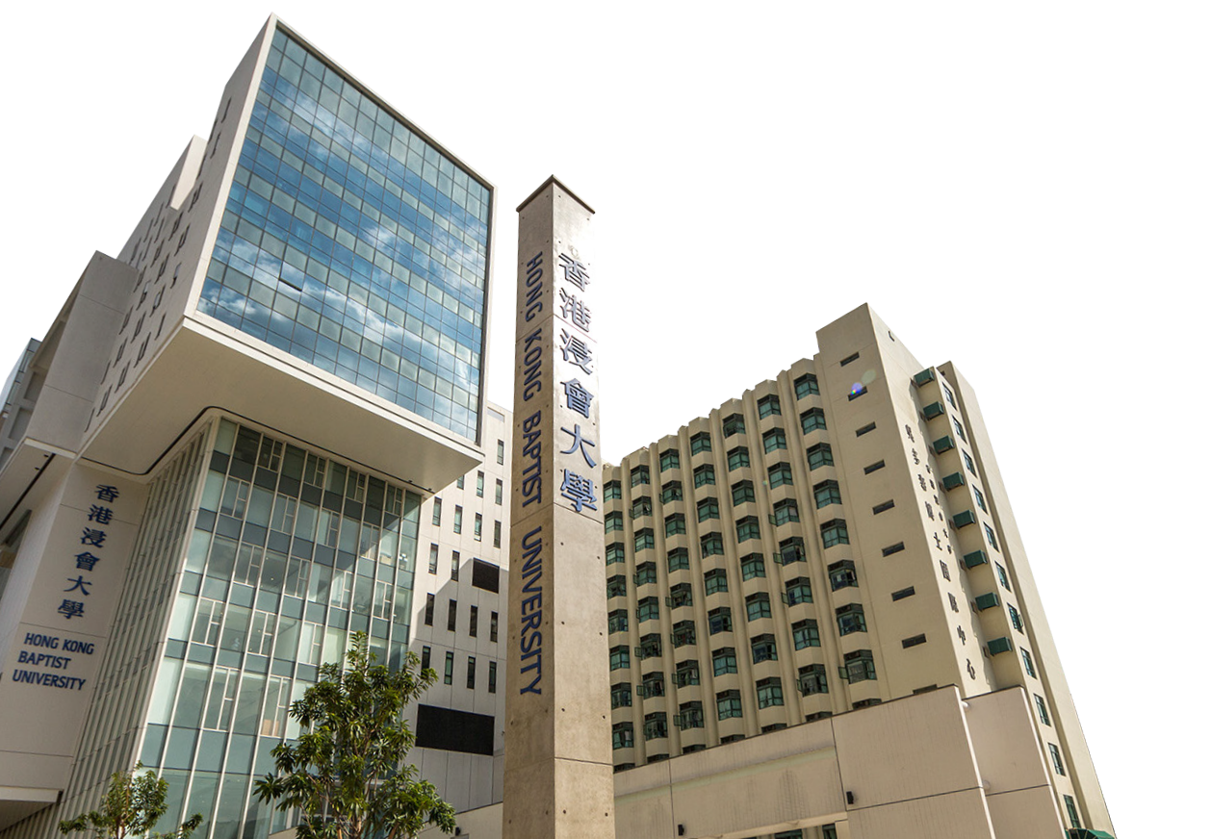
Vision
To be a leading liberal arts University in Asia for the world delivering academic excellence in a caring, creative and global culture.
Global
Caring
C reative

Slide 6

HKBU Strategic Priorities 2018-2028
BEST STUDENT EXPERIENCE
  RESEARCH EXCELLENCE
  CAPACITY BUILDING

Slide 7

COMMUNICATION
Creative Arts

Slide 8
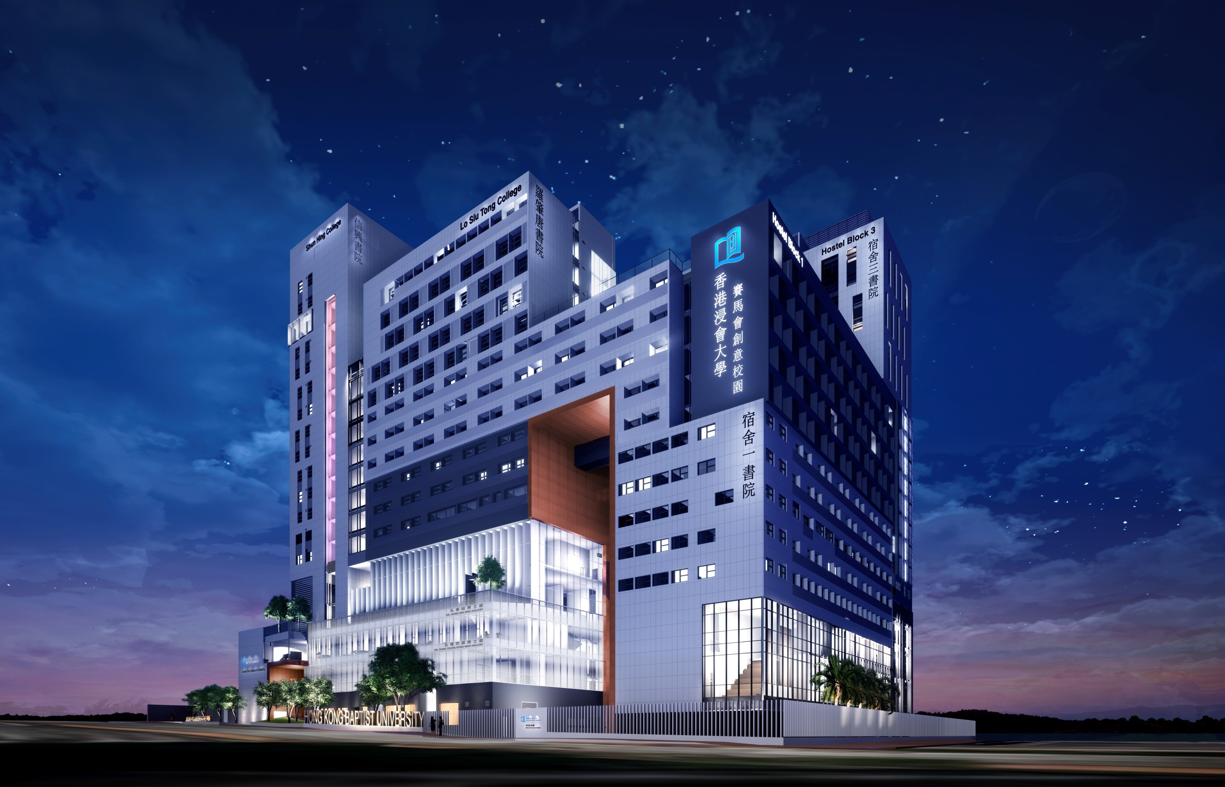
Jockey Club Campus of Creativity 2024

Slide 9
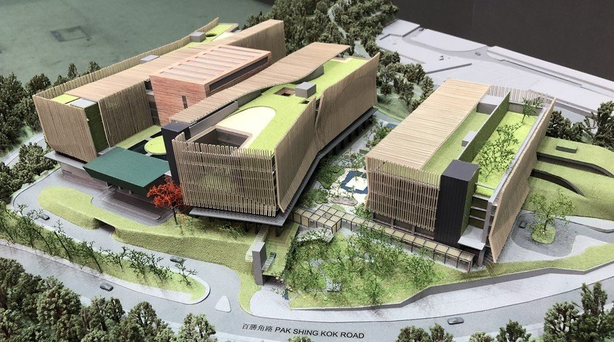
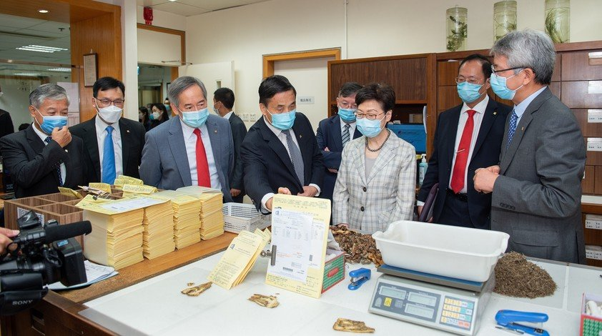

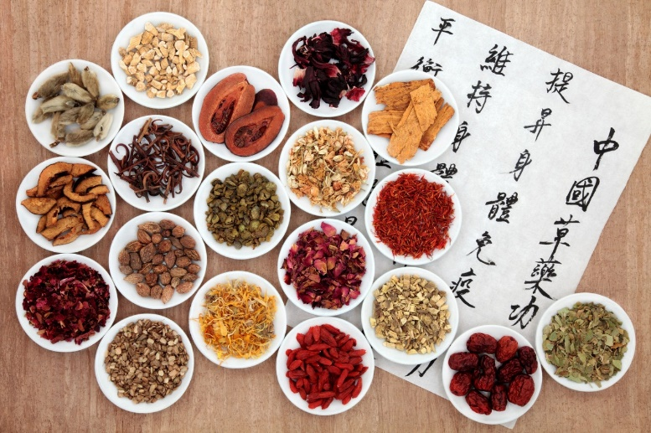
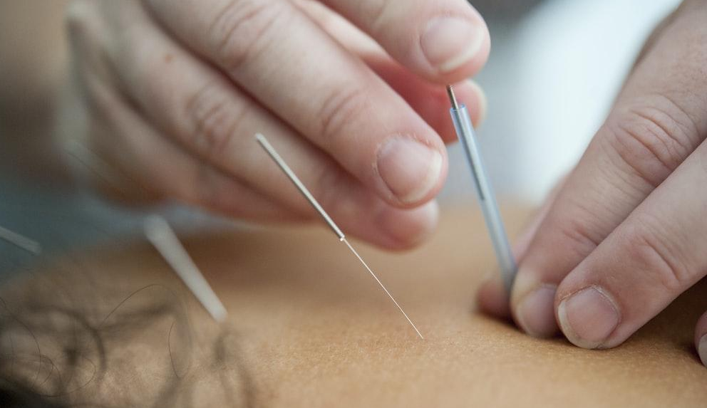

Hong Kong’s 1st Chinese Medicine Hospital 2025
HKBU operates Hong Kong’s flagship
Chinese Medicine Hospital
Hub for Chinese medicine clinical teaching and scientific research

Slide 10


Student Life Cycle Management System
2024
Admission
Alumni Engagement
Registration
Student Finance, Scholarships and Financial Aids
Prospective Students
Students
Graduates
Alumni
Tracking Student Status, Academic Records and Progress
Student Life Cycle
Student Survey and Feedback
Academic Advising
Compilation of e-Portfolio and Student Achievement
Grades and Assessment
Participation in Activities
Access to Facilities / Resources

Slide 11


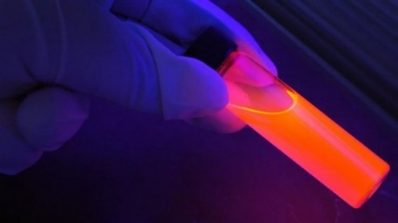






Transdisciplinary Research
3 Research Clusters + 6 Interdisciplinary Laboratories
Augmented Creativity Lab
System Health Lab
Computational Medicine Lab
Arts, Culture,
Creative Media
Health,
Chinese Medicine
& Drug Discovery
Science
Technology
AI
Big Data
Data Economy Lab
Smart Society Lab
Ethical and Theoretical AI Lab

Slide 12

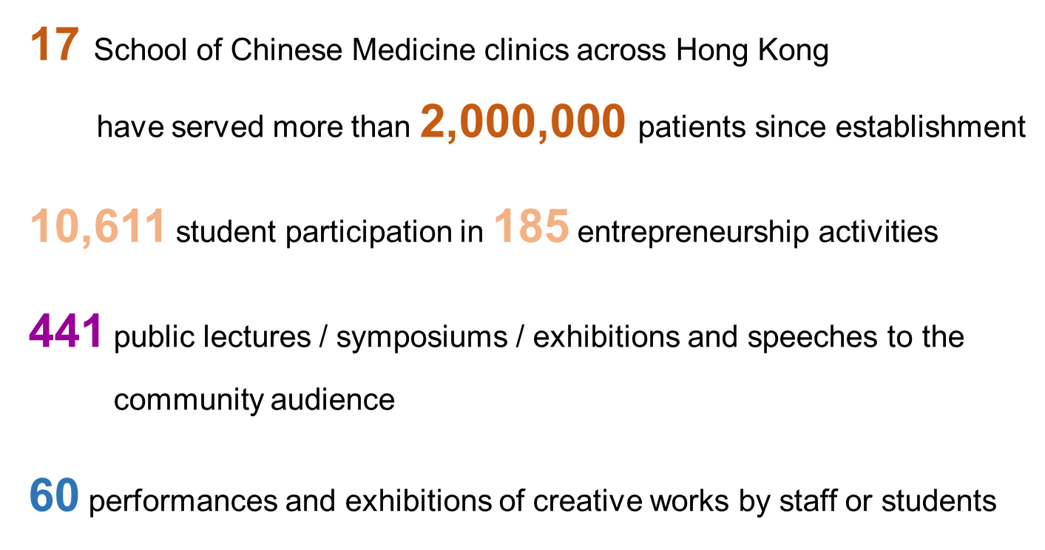



Social Impact
Note: Reporting period is from 1 July 2020 to 30 June 2021

Slide 13







Whole Person Education
Global Citizens of the 21st Century
7 HKBU Graduate Attributes

Slide 14


Slide 15
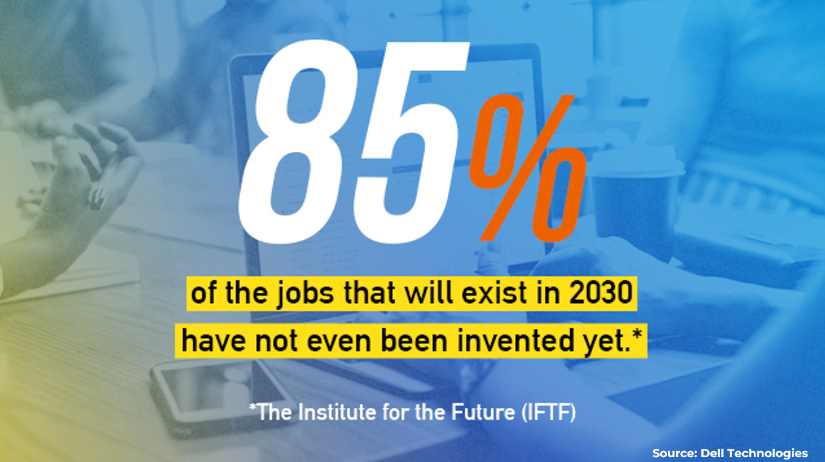

Slide 16
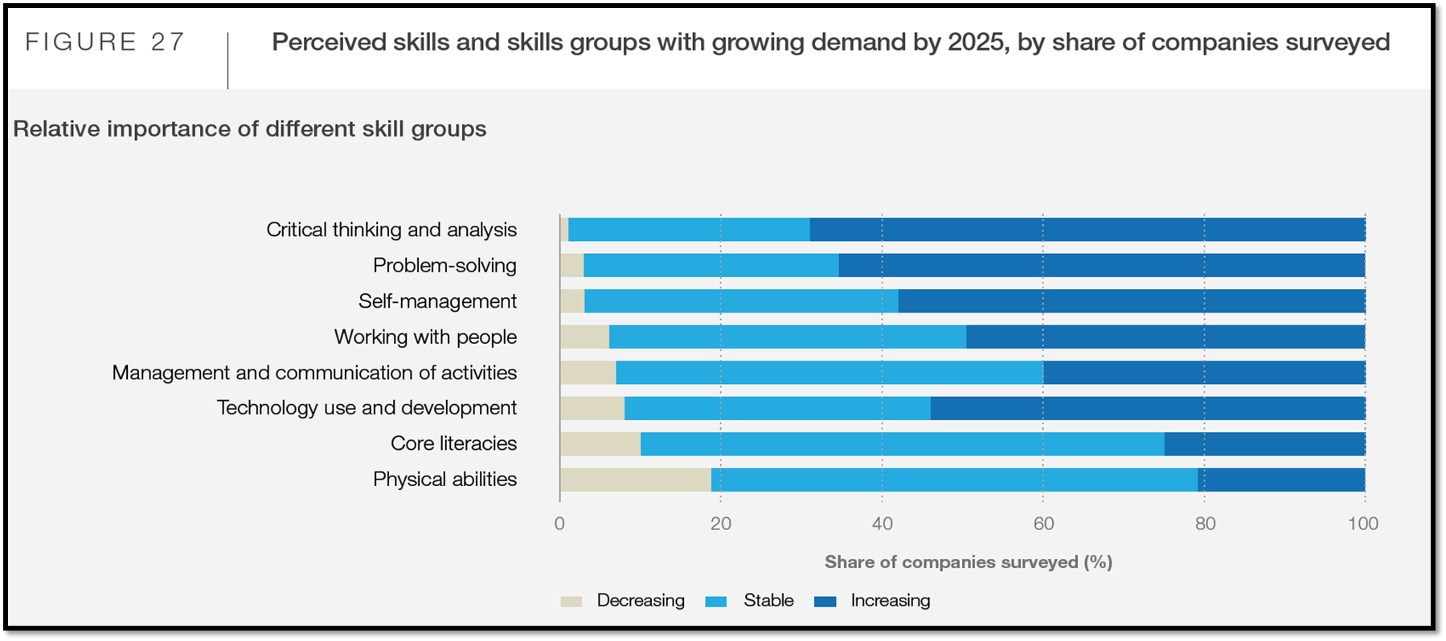
Future-ready Students
16
  + Innovation and Creativity
  + Empathy and Cultural Awareness

Slide 17
17
Transdisciplinary Education
Key Features |  | Crucial Abilities
Problem-oriented & Solution-based Authentic & Contextualized Multiple Disciplinary Perspectives Integration of Knowledge & Skills |  | Complex Problem Solving Active & Fast Learning Critical & Creative Thinking Cross-boundary Collaboration
Solution-based Learning + Co-designed Coursework
<Dedicated Advisor>
Customized
Flexible
All-round

Slide 18





18
Arts & Technology
Arts, Science & Technology
(Personalised Pathway)
Global Entertainment
Innovation in Health
and Social Well-Being

Slide 19

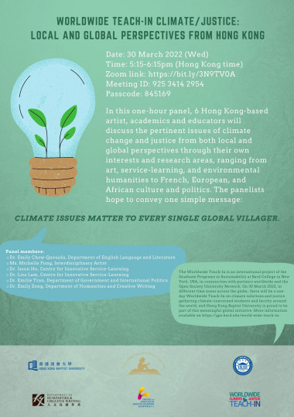

Social Innovation

Slide 20
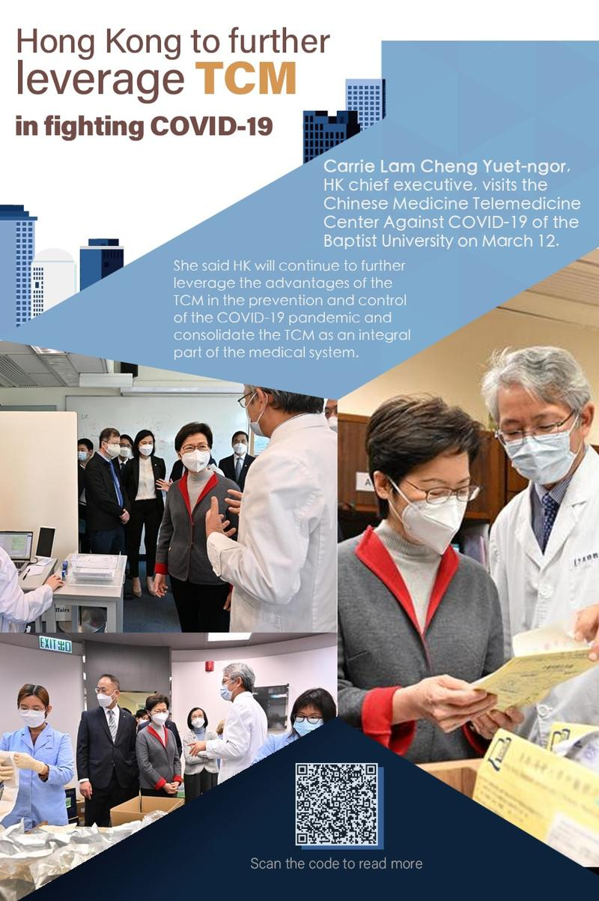
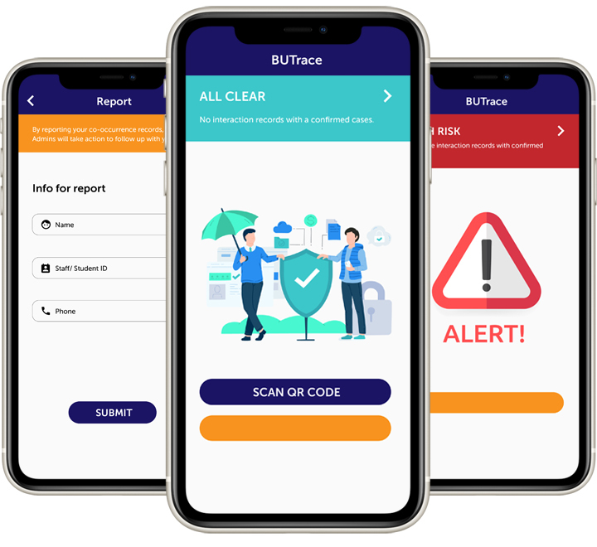
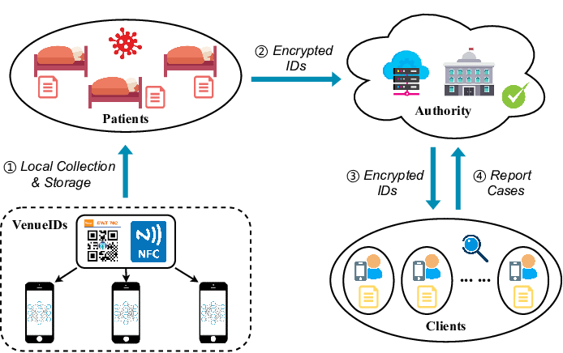
Advance In
Times of Pandemic
Free Chinese Medicine
For COVID-19 Patients
(Online Advisory, Consultation & Free Medicine Delivery Service)
BU-Trace
(A Mobile System for Privacy-Preserving Intelligent Contact Tracing)

Slide 21
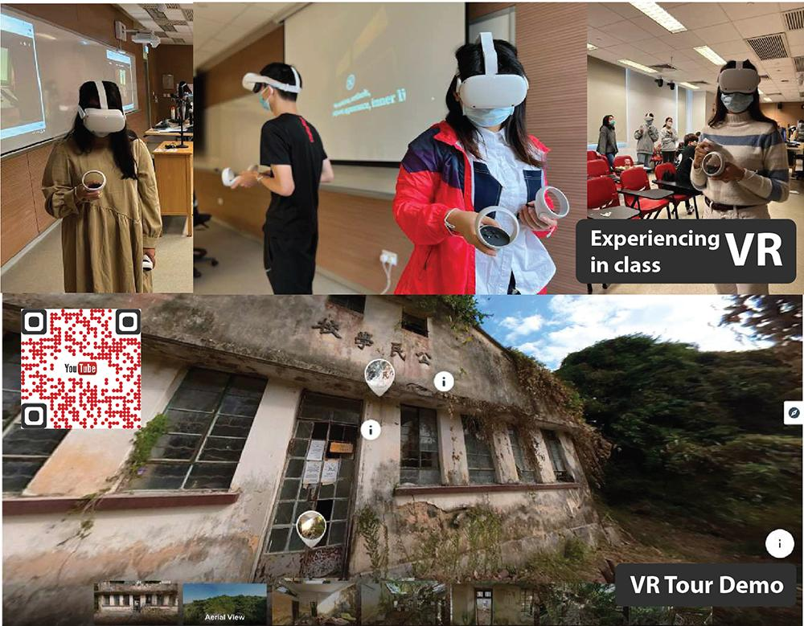
Advance In
Times of Pandemic
Adoption of e-Pedagogies for Teaching & Learning
(100 % E-learning Adoption)
Smart Classrooms
Innovative Pedagogies for Online/Mixed-mode Teaching (e.g. Virtual Presentation, Peer-review of Group Projects)
Authentic assessment

Slide 22
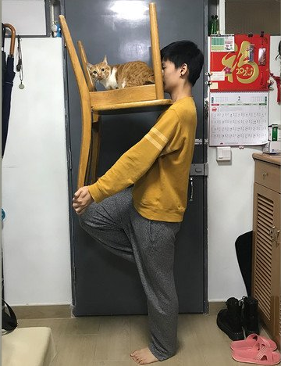
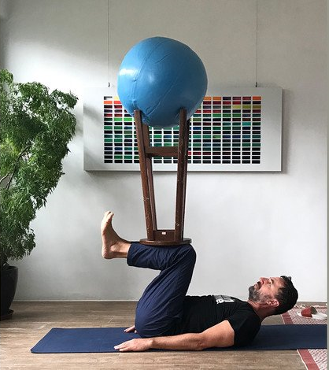
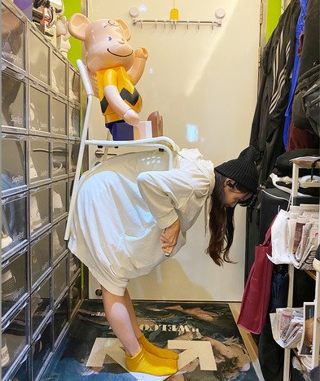
Online teaching balancing and positioning in a sculpture class using materials from home

Slide 23












23
Virtual Exchange
Virtual Experiential Learning
In collaboration with
62 partner universities in 23 countries
1600+ students from 12 countries
joined our partnered virtual activities
^{Late Night Dialogue}
^{Cooking Challenge}
Virtual Co-teaching
& Guest Lecturing
^{A day in Chile}
27faculty members from
11 partner universities in 5 countries
Virtual Research Internship

Slide 24





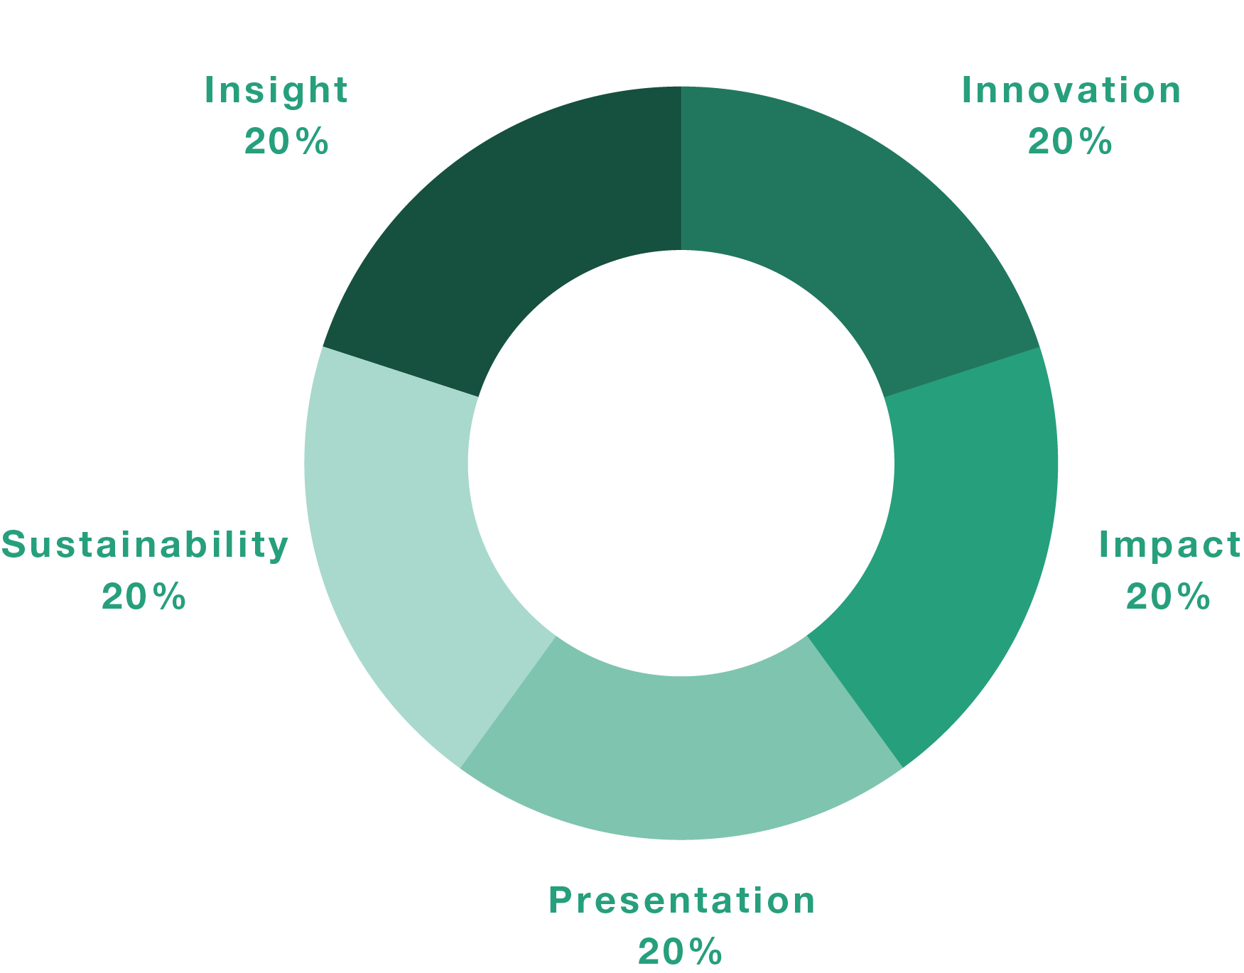



Global Virtual Hackathon 2021
Hack For A Sustainable ‘New Normal’
Four Goals
Young Talent Development Project
Real world issues with innovative minds
Creative solutions for the betterment of community
Intercultural engagement
Network building
Design thinking
Social innovation
Call for Global Innovators!
Five
Core
Indicators
180 students
38 countries/regions
20-hour time difference
Co-organized with

Slide 25





Ideas on Future Collaboration
Hackathon
Transdisciplinary Initiatives
SDG-Related
Activities

Slide 26
Proposed PALAC Hackathon
Hands-on development of practical innovations for real challenges under selected SDG(s) over a weekend
Students form Innovation Teams comprised of at least 2 PALAC Member institutions
Coverage:
  Innovation bootcamp – covering SDGs, design thinking, pitching, team formation
  Brainstorming and ideas generation
  Solution development – creation of poster, 3-minute video (24 hours)
  Competition and awards
Members contribute SDG challenges, courses for the bootcamp, facilitators, mentors and judges

Slide 27
THANK YOU

